Slide 1

Evolv Introduction

Slide 2

Training Housekeeping
General
Please be on time
Abstain from using your personal cell phone.
Respect other’s opinions and space
Remind staff who the temporary on-call person is while you are in training

Slide 3
Training Housekeeping
We help each other grow
  Speak from your experience
  Accept constructive criticism with grace
  Respect each other
Let’s not interrupt our learning experience
  No side conversations, keep the microphone on mute unless speaking
Be here now
  Participants are encouraged to be on video, particularly during breakout sessions
  Minimize “coming and going” during the training
  Take care of yourself
Fill out the quiz at the end of the presentation, it will be used to keep attendance

Slide 4
GOAL
Ensure staff can log into & navigate through the myevolv electronic health record system

Slide 5

OBJECTIVES
Understand how to find Evolv and login
Understand how to navigate to frequently used areas of Evolv
Become familiar with common terms and symbols of Evolv

Slide 6
Prerequisites for Using Evolv
1. Internet Explorer (internet browser)
2. Internet Explorer’s settings customized
a) Usually set up prior to staff receiving their computer
b) Settings instructions are attached to every new Evolv User email in case you need them
3. Internet Connection
4. Login and Password for Evolv
a) If you don’t have this yet, let your Program Director know
b) Program Directors: please send request to:Evolv@casaesperanza.org
c) Someone from the Evolv Team will provide login
information

Slide 7


The Website
Evolv is a cloud-based software system that is accessed via a website and can be logged in from any computer.
Each company that uses Evolv has their own unique URL (web address)
  You cannot access Evolv by doing a web search, because we have a CASA specific URL
We have 2 main databases (webpages)
  Production: Our main database, hosting all clients’ real time data
  Development: A copy of the production database, where staff can practice creating forms, navigating the system, ect.
Evolv can be used in Google Chrome and Microsoft Edge
All CASA computers have a shortcut saved to the Desktop for easy access.

Slide 8
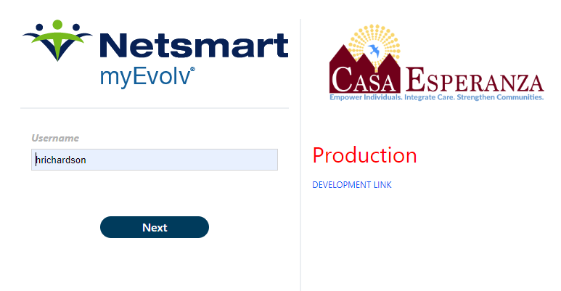
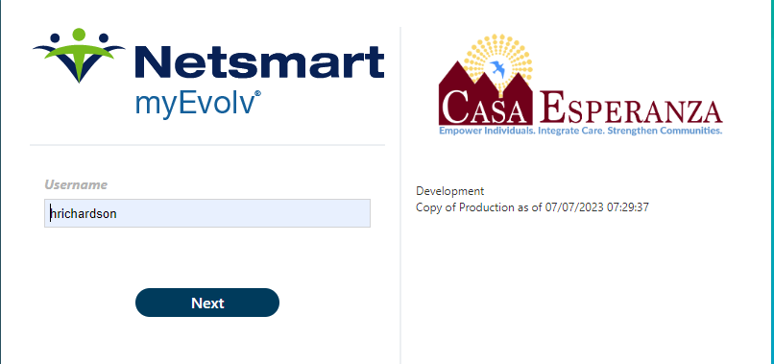
Production vs. Development
Production Database
https://myevolvcespxb.netsmartcloud.com/Account/Login.aspx#!
Development Database
https://myevolvcespdevxb.netsmartcloud.com/Account/Login.aspx#!

Slide 9
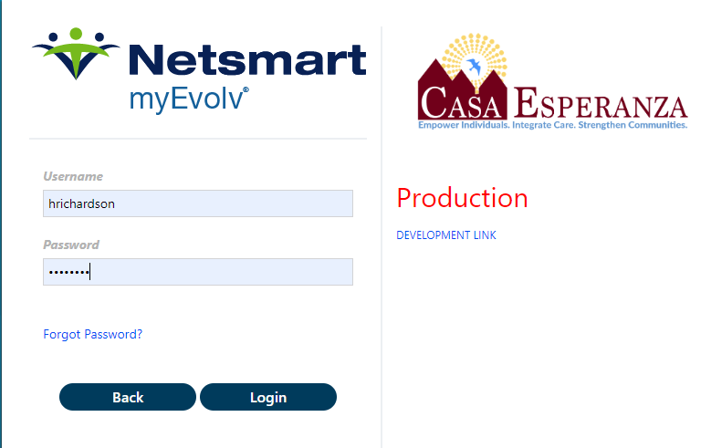
Logging In
Double Click on the Evolv Shortcut
Or
2. Open Google Chrome & Go to the Evolv website: https://myevolvcespxb.netsmartcloud.com/Account/Login.aspx#!
3. Enter the username/password provided by IT
4. Click Login

Slide 10
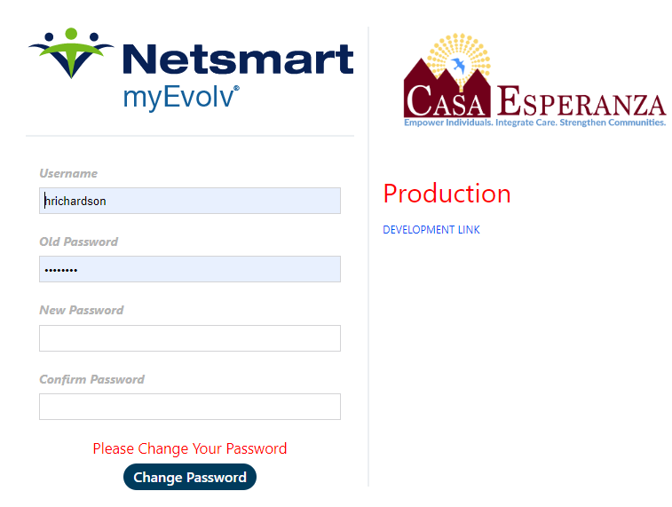
New User Login
If this is your first-time logging into Evolv, the system will prompt you to create a new, unique password.
  When the screen asks for your “old password”, enter the password provided to you by IT.
  In the “new password” field, enter your own private password
  Click Change Password

Slide 11
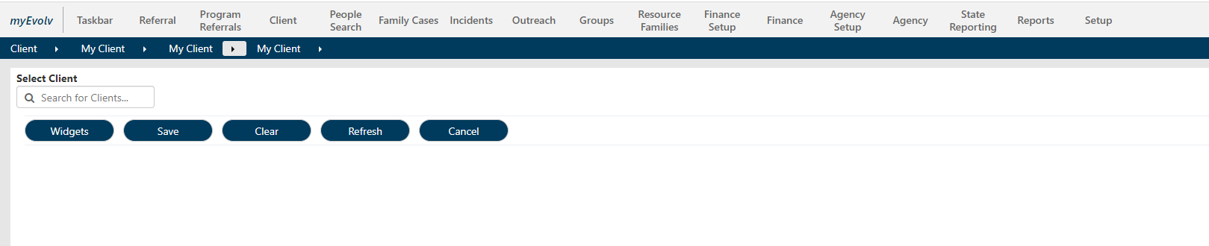
Logging In
When you 1st log in, you will see a screen like this:
You will not see any client data, as we are looking at the equivalent of a closed file cabinet.
We haven’t told the database which drawer (or client) we want to open yet.

Slide 12
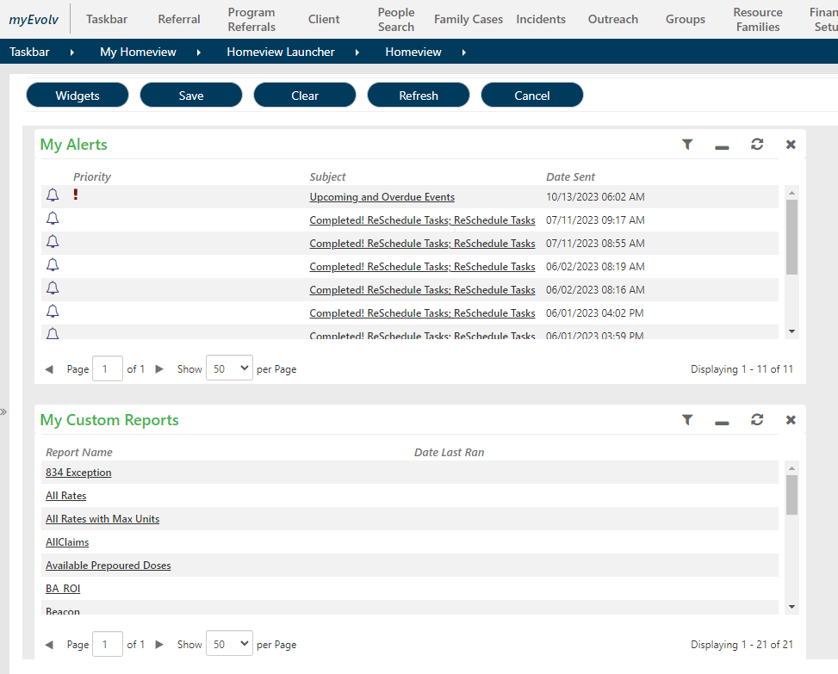
Navigating Evolv: Homeview
If you think about Evolv as a file
cabinet, Modules are like each
drawer of the file cabinet.
When you click on the Evolv button,
this will bring you to your
“Homeview”. This is where you can
Set up your “Widgets”

Slide 13
Navigating Evolv: Homeview
Widgets allow you to view information, see a to-do list, and perform tasks such as review alerts sent to you. Widgets list items that need your attention and include icons and links to forms where you can update information and perform related tasks, such as entering a progress note.
Widgets can be customized and added. Access to certain Widgets is based on your job role & function.

Slide 14
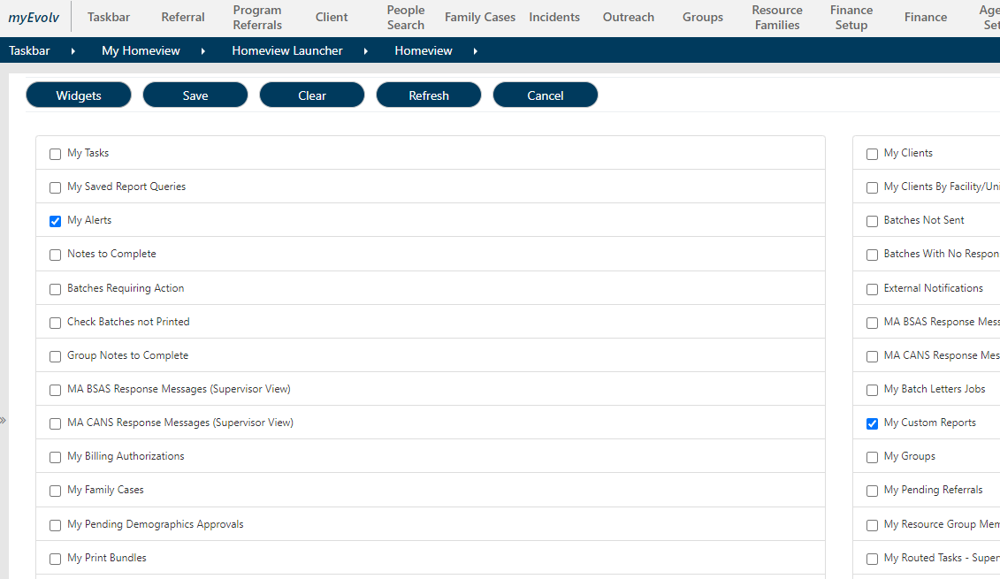
Navigating Evolv: Homeview
Clicking the “Widget” button will allow you to customize your homeview.
The widgets listed are the widgets that are available to you based on your job role & function. Check the box next to any widget you would like to include on your homepage.

Slide 15
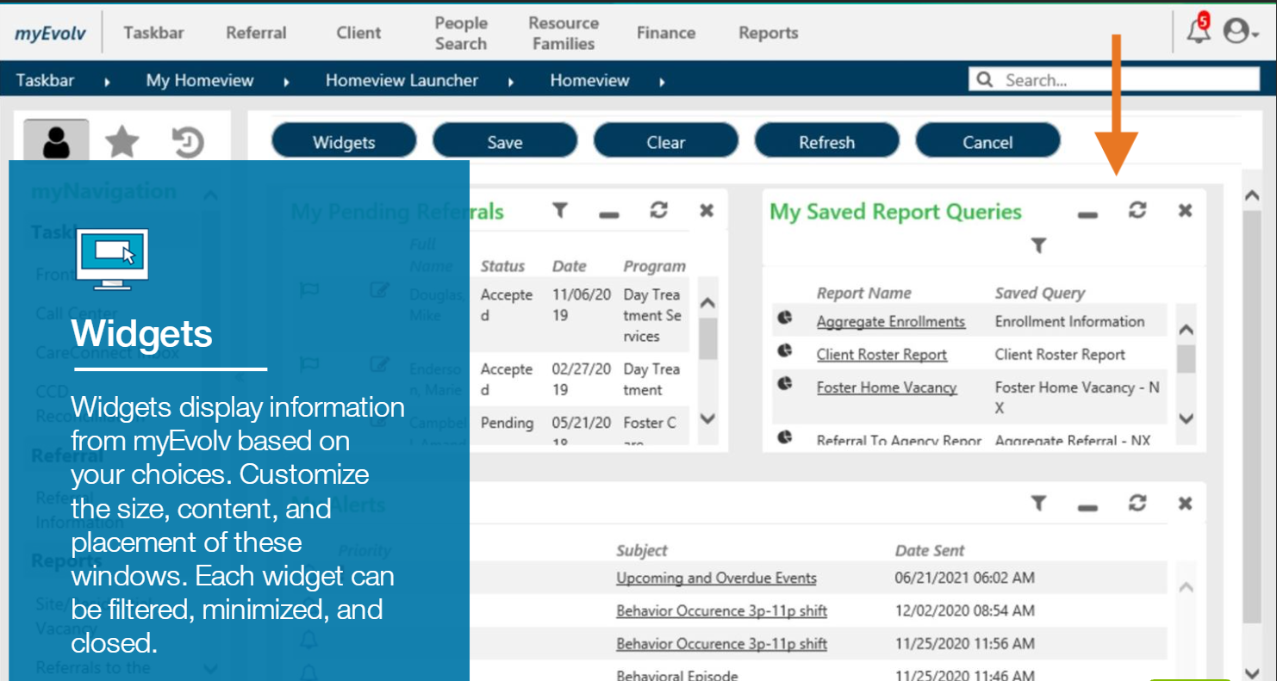
Navigating Evolv: Homeview

Slide 16
Navigating Evolv: Modules
Evolv modules are listed across the top tool bar (in gray)
Staff will have access to the modules they need based on their job role & function.
This means some staff may have different modules listed.
Modules contain forms for completing tasks

Slide 17
Navigating Evolv: Modules
Referral Module:
  The place to store information for people who are not patients yet
  People who have been accepted but have not entered a program yet
Client Module
  The chart that stores all information for patients who are officially enrolled in our programs
Group Module
  The area to record group notes & individual notes for people who participate in groups
  All notes will link back to the patient chart
  Much more efficient than logging into each individual chart to write individual group notes.

Slide 18
Navigating Evolv: Important Fact
A good amount of the data entered into the patient’s chart is linked to the patient (not just stuck within that one form); which means it will show up with the patient in the following areas of evolv:
  Their Referral Chart
  Their Client Chart
  In different forms
  In many different places within the chart
  Examples: Demographics, Medications, Diagnosis, and more

Slide 19
Navigating Evolv: Helpful Hint
  As you are practicing within Evolv, a good practice is to copy down the breadcrumb to the page you were in so you can find your way back to it later!

Slide 20

Navigating Evolv: Important Fact
  Sometimes you will see an icon right next to the Patient’s name
  Scroll over the icon (you do not have to click on it)
  These are alerts
  Examples of Alerts:
    Certain medical conditions
    Campus barring
    Restraining Orders
    Ect.

Slide 21
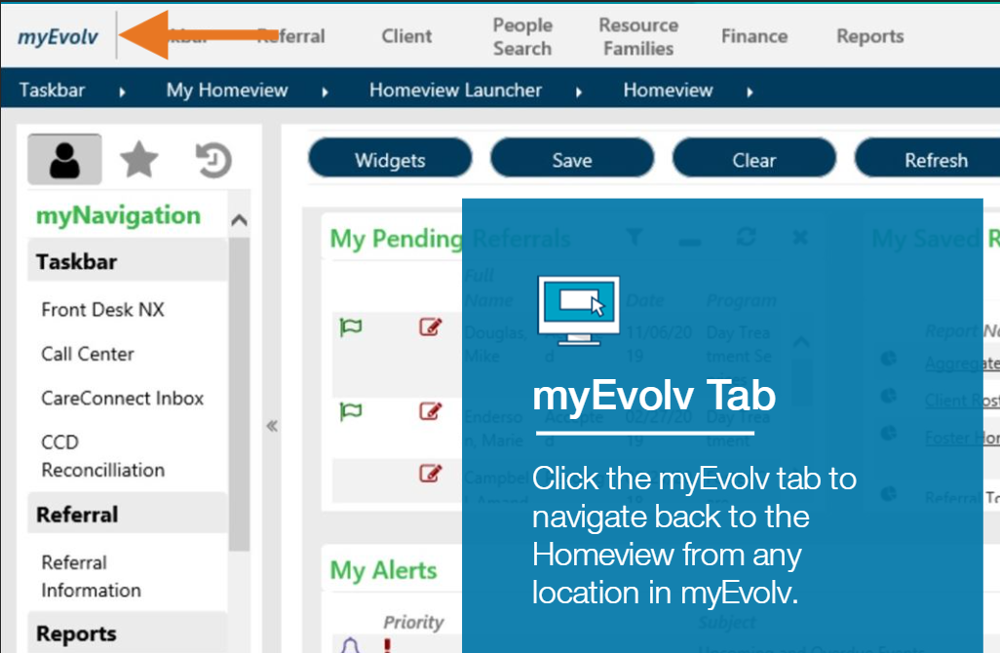
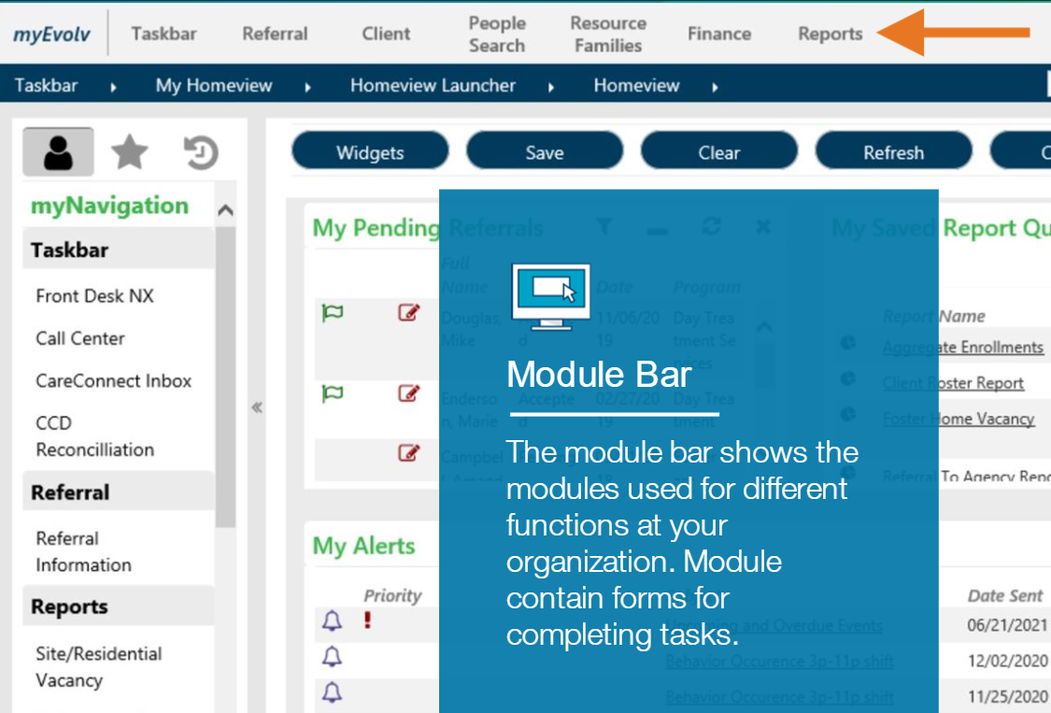
Navigating Evolv Review: Evolv’s Layout
  Different Parts of the Landing Page:

Slide 22
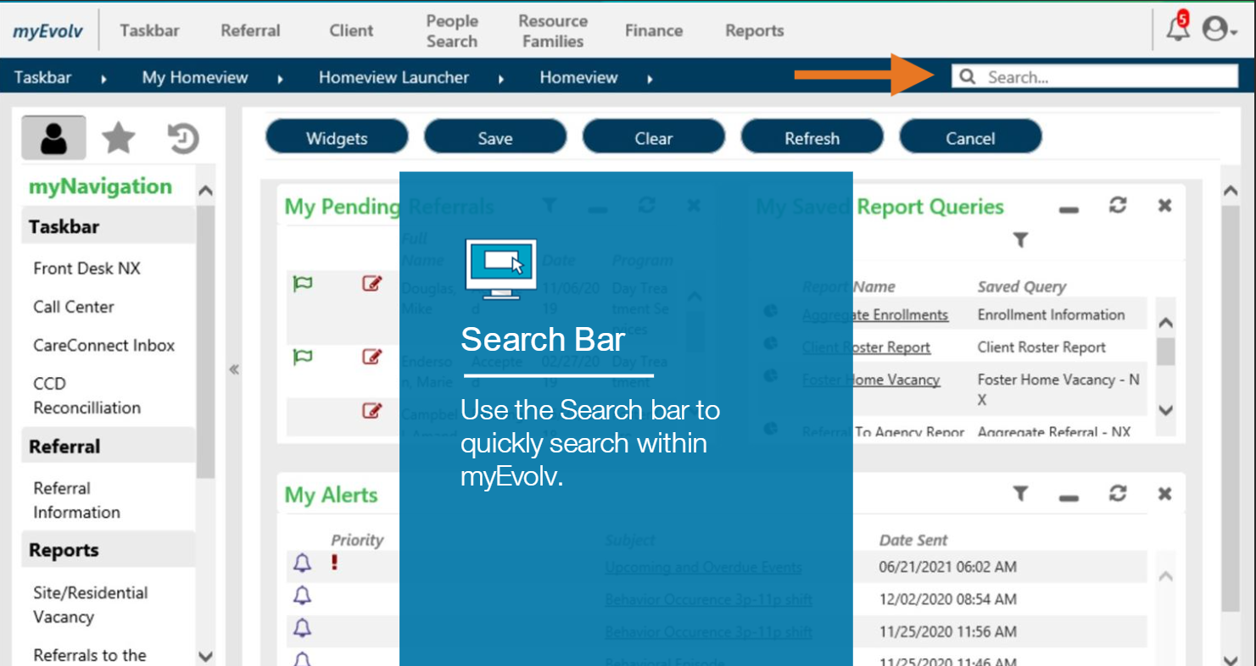
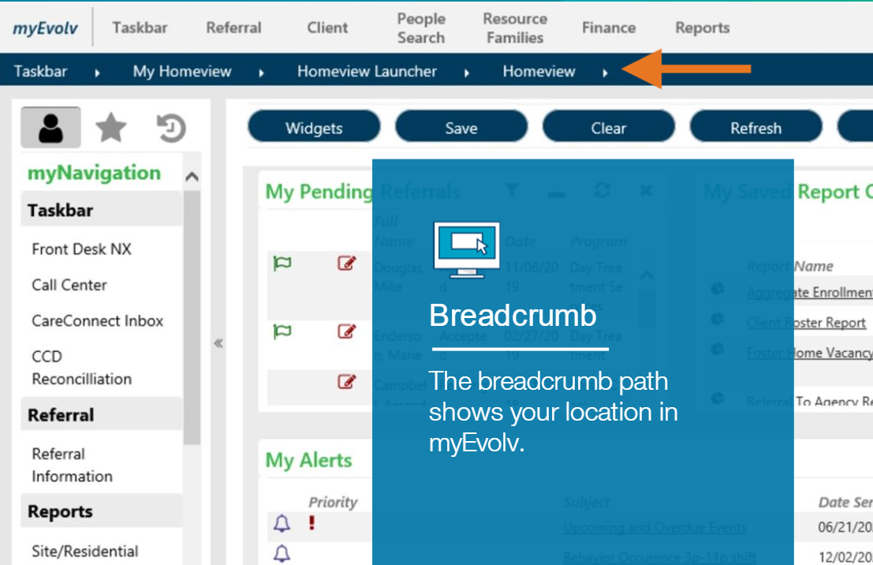
Navigating Evolv Review: Evolv’s Layout
  Different Parts of the Landing Page:

Slide 23
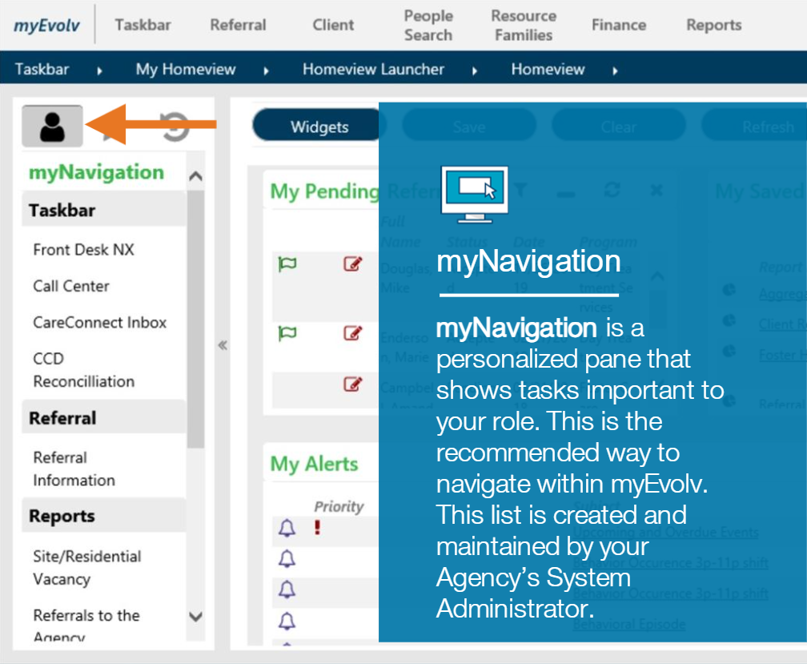
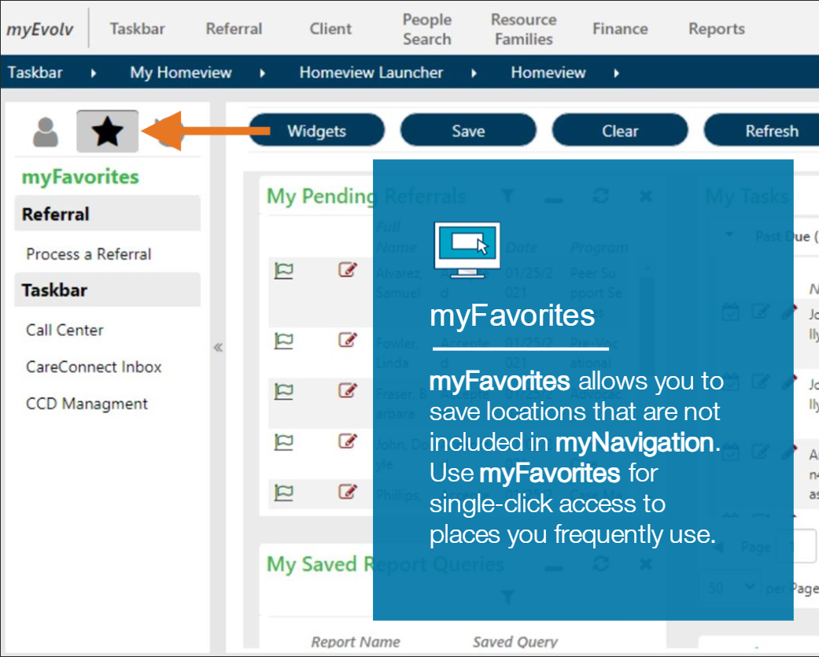
Navigating Evolv Review: Evolv’s Layout

Slide 24
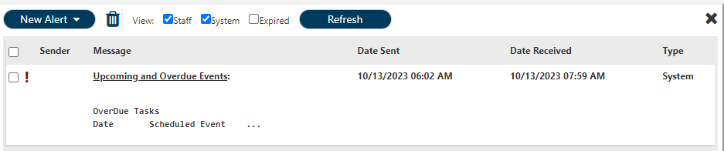
Navigating Evolv Review: Evolv’s Layout
Staff Alerts
There is a second type of “Alert” in Evolv, this alert is part of the Internal Messaging System
Staff will receive alerts, and a numbered notification will show in the top right of the screen on a bell.
Alerts can be sent from a supervisor, other staff members, or automatically from the system
Click on the bell, the alert notification box will open, then click the message link

Slide 25
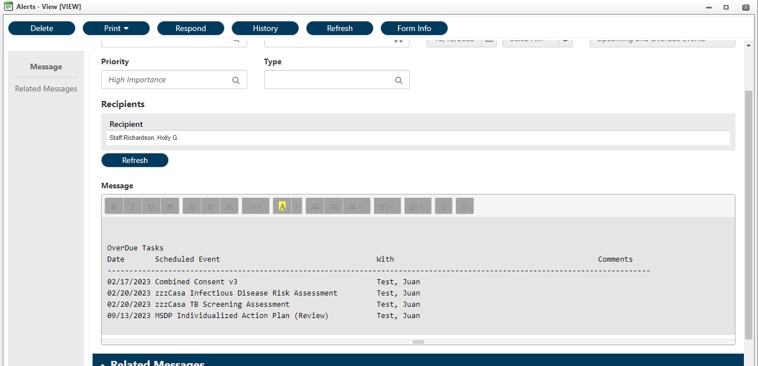
Navigating Evolv Review: Evolv’s Layout
Staff Alerts:
The window will open and display the message from the alert window. In this example, it shows the overdue tasks for a certain patient.

Slide 26
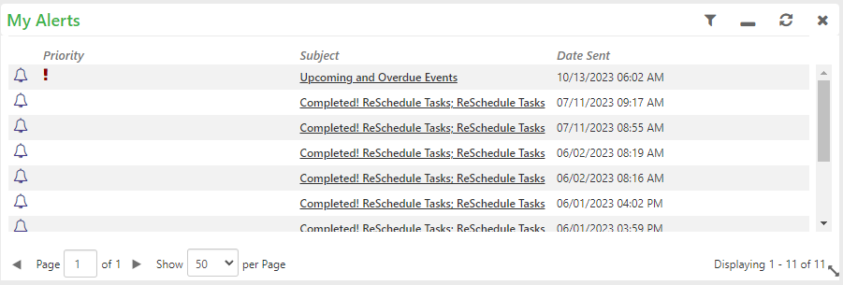
Navigating Evolv Review: Evolv’s Layout
Staff Alerts:
Alerts can also be displayed in your “Homeview” by selecting the Alerts “widget”. This way any alerts you receive will be displayed each time you go into your Homeview.

Slide 27
Navigating Evolv Review: Common Terms
The Breadcrumb:
Is the address for where you are in Evolv. This is important to share with Evolv Support if
you ever need assistance. Some sub-modules in Evolv are named the same even though they are part of different Modules.
Sharing the Breadcrumb with ensure Evolv Support is looking at the same thing you are.
Staff Alerts:
You will receive different types of alerts at different times. Some alerts are direct messages from other staff
while others are automated messages when you are assigned new clients or when certain tasks are assigned to you.
**Note**
There are many different ways to get to the same area within Evolv. Navigating Evolv is a matter of personal preference. You may use whichever mode is easiest for you!

Slide 28

Thank you!
Questions?

