Slide 1

Progress Notes & Group Notes

Slide 2

Training Housekeeping
We help each other grow
    Speak from your experience
    Accept constructive criticism with grace
    Respect each other
Let’s not interrupt our learning experience
    No side conversations
    Keep the microphone on mute unless speaking
Be here now
    Participants are highly encouraged to be on video
    Minimize “coming and going” during the training
    Take care of yourself
    5-minute break will occur ~ 10 AM
*Fill out the quiz at the end of the presentation, it will be used to keep attendance*

Slide 3

GOALS & OBJECTIVES
Goal #: The Goal for this training is for staff to become familiar with the tools to document a patient’s progress in Evolv.
Objectives:
At the end of this training, participants will:
• List 3 different ways we track and support patient’s progress to recovery
• Know how to access and enter a Progress Note for a patient
• Know how to enroll patients into a Group
• Know how to enter Group notes for patients
Notes:
Not included in the powerpoint

Slide 4
Background
Remember: Using Evolv involves doing things differently; some forms and steps are changing
• Opportunity for broader change:
      More thorough assessment upfront
      Increased collaboration with Outpatient
      More transparent, trauma-informed engagement with patients around program expectations and safety planning
      Strengthening use of Phases in treatment that match patient's status of change
• As we learn steps, will also start to map process—who, what, when, where, how
Notes:
Not included in the powerpoint

Slide 5
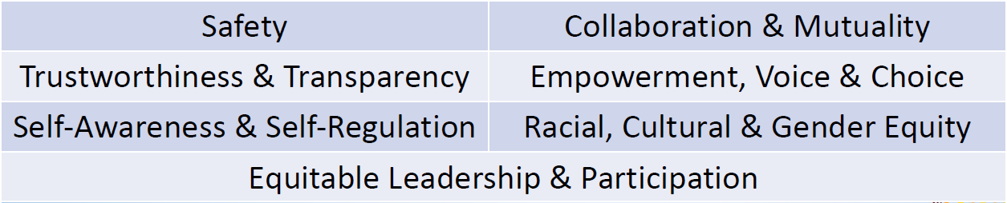
Review: Principles of Social Justice & Trauma- Informed Care
Notes:
Not included in the powerpoint

Slide 6

Patient Progress
What frameworks do we use to understand patients’ progress to recovery?
• Goals and objectives of treatment plan
  Is patient actively working toward meeting treatment objectives?
  Use case management, skill building, substance use counseling, and many other evidence-based strategies to support
• Program phases
  Is patient stabilizing into program routine and meeting requirements to move into next phase?
  Use clear guidelines, coaching, mentoring, and therapeutic value of
  program structure to support

Slide 7
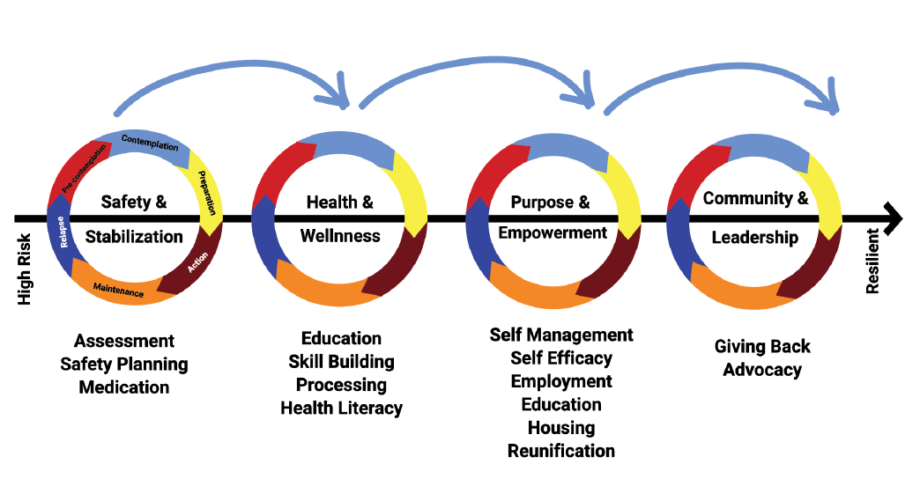
Phases of Treatment

Slide 8
Patient Progress
What frameworks do we use to understand patients’ progress to recovery?
• Status of change
  Is the patient moving through the status of change?
  Use motivational interviewing and other evidence-based strategies to support
• Risk & Resiliency
  Is patient's level of risk reducing, and is patient's resiliency (through internal strengths & external resources) increasing?
  Use case management, skill building, substance use counseling, and many
  Other evidence-based strategies to support

Slide 9
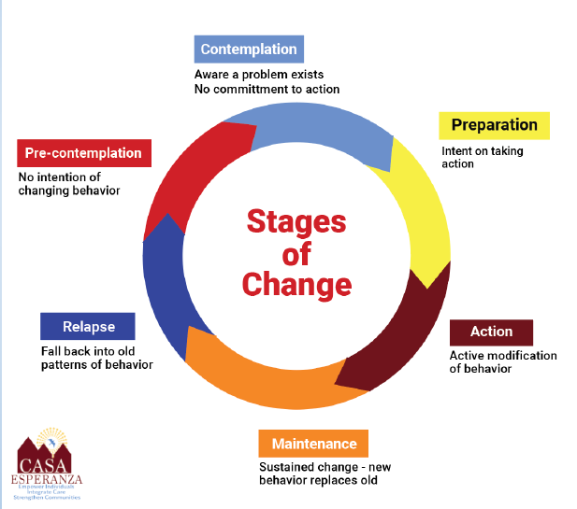
Stages of Change

Slide 10
Patient Progress
What are the tools that help us monitor patient progress?
• Progress Note
  Connected to treatment plan
• Group Notes
Phase Review
  Enter new Phase when patient changes phase
  Phase will pull into many other forms
  As we review phase tasks, we will build Phase Review Form
Treatment Plan Review
  Complete review every 30, 60, or 90 days

Slide 11
Patient Progress
What are some other tools that help us monitor patient progress?
• ASAM @ Reauthorization
  Connected to treatment plan
• MDT Meetings

Slide 12
Progress Note
• Based on SOAP/DAP (Subjective, Objective, Assessment, Plan/Data, Assessment, Plan format
• Need to answer the questions:
  How is the patient doing (subjectively & objectively)?
  What progress are they making towards their goals & objectives?
  What did you do for them to help them meet their goals & objectives (interventions)?
  How did they respond?
  What is the plan going forward?

Slide 13
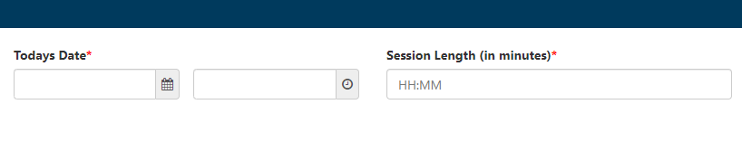
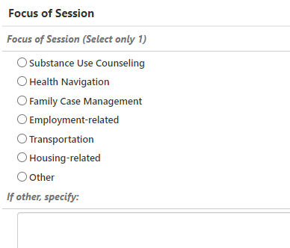
TX Coordinator Progress Note
FIRST:
Enter Date/Time (required)
Enter Length of Session (required)
Select the Focus of the Session
  Allows us to track the kind of work we do with our patients, and how much support patients receive in different areas

Slide 14
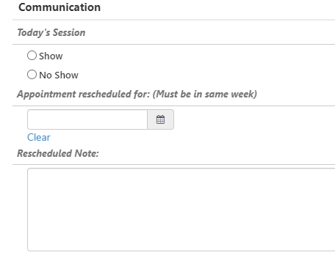
TX Coordinator Progress Note
FIRST:
If No Show, record communication you had with the patient and scheduling of another session (within the same week)

Slide 15
TX Coordinator Progress Note
Presenting Issues:
Subjective
  What do they say about how they are doing (in the client's own words)?
    E.g., "I'm angry with my roommate.
      Can be written in Spanish, but English translation must also be provided.
Objective
  Reported symptoms & facts
  Symptoms you observe
  E.g., "Pt reported that he had a disagreement with roommate today.
  Pt was irritable & reported feeling depressed and frustrated having
  an increased wish to leave program.

Slide 16
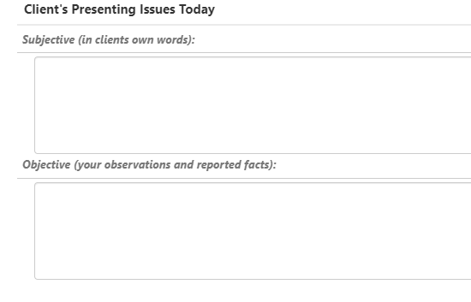
TX Coordinator Progress Note
Presenting Issues:
Subjective
Objective

Slide 17
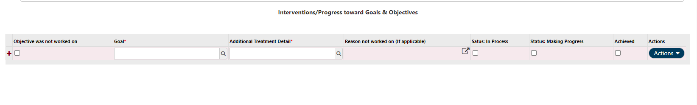
TX Coordinator Progress Note
Interventions/Progress:
Click on the magnifying glass next under "Goal" to select the Goal & key objectives from the Treatment Plan that are the focus of your work at that moment
  Note: Only Goals entered into the treatment plan will appear as selection
  options
Note Patient's progress towards the Goal or Objective
  In Process: Patient is struggling with this goal
    Focus on trying to understand what is getting in the way
  Making Progress: Patient has begun to take steps and make gains
  Achieved: Patient has achieved this goal or objective

Slide 18
TX Coordinator Progress Note
Interventions/Progress:
If you did not work on a Goal or Objective that is a current focus, you can also select the objective, check the box that it was not worked on and complete the box to insert the reason this was not worked on.

Slide 19
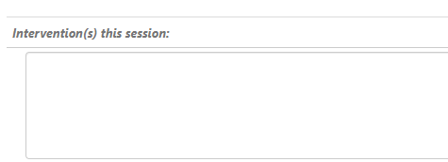
TX Coordinator Progress Note
Interventions this Session
  Summarize what you did in the session today, mentioning all objectives you worked on.
    E.g., "This writer worked with pt to practice new strategies for communicating with roommate. This writer reviewed safety plan with pt to identify ways to manage stressful interactions with roommate. This writer worked with client on housing application

Slide 20
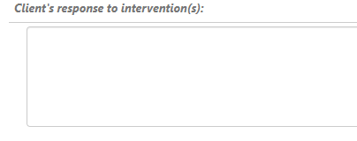
TX Coordinator Progress Note
Client's Response to Interventions
  How did patient respond?
    Did patient engage in the work?
    Did they not engage?
    Did they seem calmer at the end of the session?
    E.g., "Patient responded positively to ideas for different ways to communicate with roommate. Pt states that completing housing application reminded him of why he wanted to stay in the program."

Slide 21
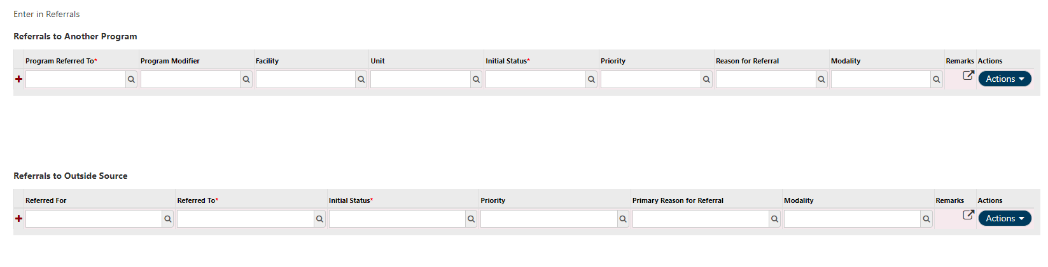
TX Coordinator Progress Note
Referrals: Enter in Referrals made during the session. Entering them here will ensure they are accessible across the chart.

Slide 22
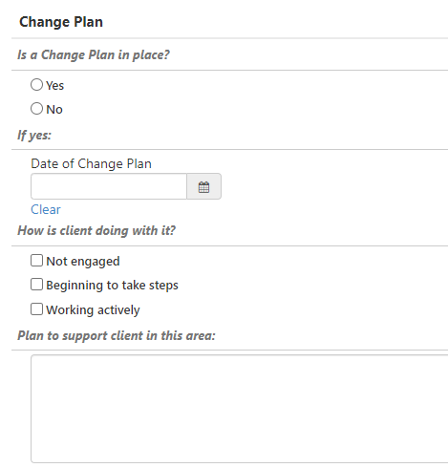
TX Coordinator Progress Note
Change Plan:
Check the box for if a change plan is in place
If yes, enter the date the change plan was completed
How is the client doing with it?
Plan to support client in this area
  E.g., "This writer will continue to help pt practice new coping skills for managing anger."

Slide 23
TX Coordinator Progress Note
Observations of Client's Presentation:
Record your observations of the patient's presentation
  Appearance
  Behavior
  Mood
  Safety Issues
Checkboxes to assist
If no concerns about a patient possibly being suicidal or homicidal, you do not have to ask them about this each time
  Select "No evidence" of Suicidal or Self harm thoughts
  Select "No evident" of Aggressive or Homicidal thoughts

Slide 24
TX Coordinator Progress Note
Observations of Client's Presentation:
If any concerns, you should ask:
  Are you having thoughts of wanting to harm or kill yourself?
  Are you having thoughts of wanting to harm another person?
If patient says yes, or if you are uncomfortable with how they answer these questions, you need to consult with clinical supervisor
Record:
  What patient said
  Your consultation with Clinical Supervisor
  Plan to keep patient safe

Slide 25
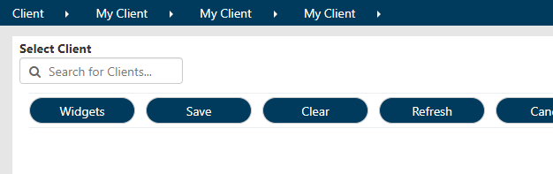
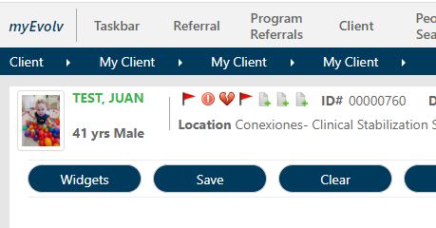
TX Coordinator Progress Note
Accessing TX Coordinator Note within Evolv:
Search for client name within the box, and select the correct client chart
Select "Client" module

Slide 26
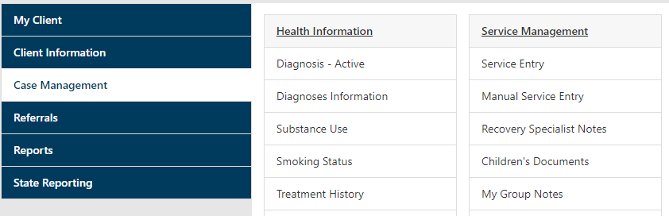
TX Coordinator Progress Note
Accessing TX Coordinator Note within Evolv:
Click "Case Management", then click "Service Entry"

Slide 27
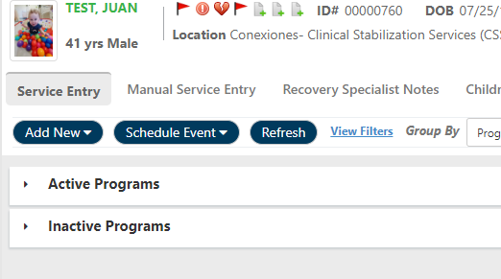
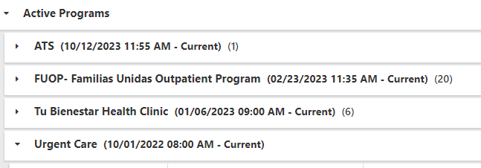
TX Coordinator Progress Note
Accessing TX Coordinator Note within Evolv:
You may see multiple Programs listed
  These are all programs that this patient has ever been enrolled in (in Evolv) at CASA
  Current Enrolled programs will be listed under the ACTIVE tab, while the programs the patient is no longer enrolled in will be listed under the INACTIVE tab.
  All programs will list the dates of enrollment.

Slide 28
TX Coordinator Progress Note
Accessing TX Coordinator Note within Evolv:
Click “Add Event” under the correct program
Search for the name of your note & click on it to select

Slide 29
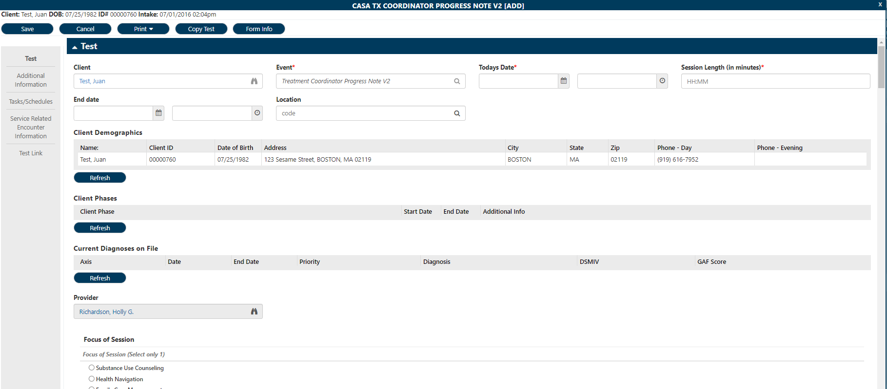
TX Coordinator Progress Note

Slide 30
Activity
In DEVELOPMENT, open a client chart & practice completing the Treatment Coordinator Progress Note

Slide 31
Group Notes

Slide 32
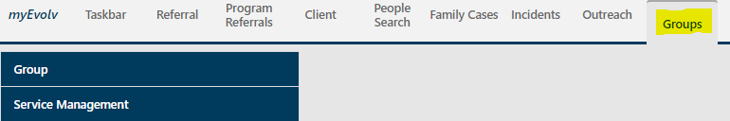
Group Notes
Groups in Evolv live in their own “GROUPS” module, separate from the “Referral” & “Client” modules you already know
Each Residential Program will have its own Group, in which all current program participants are enrolled
Whenever you lead a specific group, you then select the type of group it was (e.g., Community Meeting, Recovery Goals, etc..) and identify which of the enrolled program participants attended the group session

Slide 33
Group Notes
Each time you lead a group…
  You will write a note about the topic and interventions of the group
    This note will populate in the chart of every group participant, even though you only write it once!
  You will also write a brief note for each individual participant, describing their participation in the group and any concerns you may have
    Each of these notes will populate within the specific patient’s chart only

Slide 34
Enrolling Clients in the Group
Go to the Groups Module
Click on “GROUP”

Slide 35
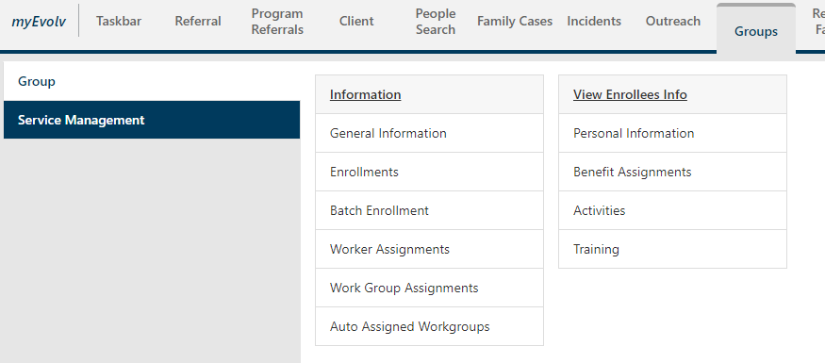
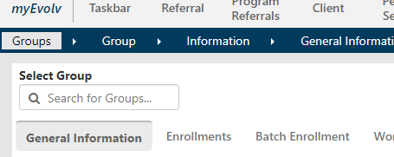
Enrolling Clients in the Group
3. Click “General Information”
4. Search for your Group Name within the search field:

Slide 36
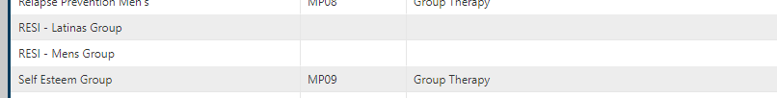
Enrolling Clients in the Group
In the search field type the name of the group (For Residential groups, type "Resi", for CSS groups, type "CSS", for Outpatient groups, type the name of the group) This will cause the groups to populate within the search
Look in the results for the name of the group you wish to choose

Slide 37
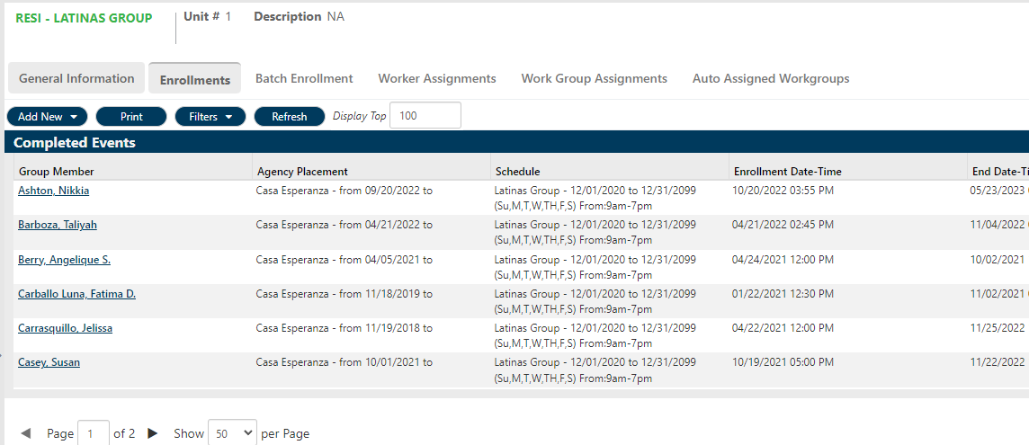
Enrolling Clients in the Group
Add a Client:
Click the tab “ENROLLMENT”
  This tab shows you all the clients current enrolled within this group

Slide 38
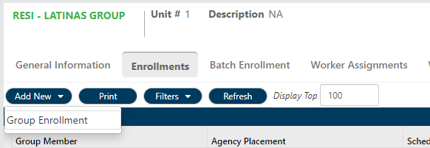
Enrolling Clients in the Group
Add a Client:
To enter a new client into the group, click on “ADD EVENT” and then “GROUP ENROLLMENT”

Slide 39
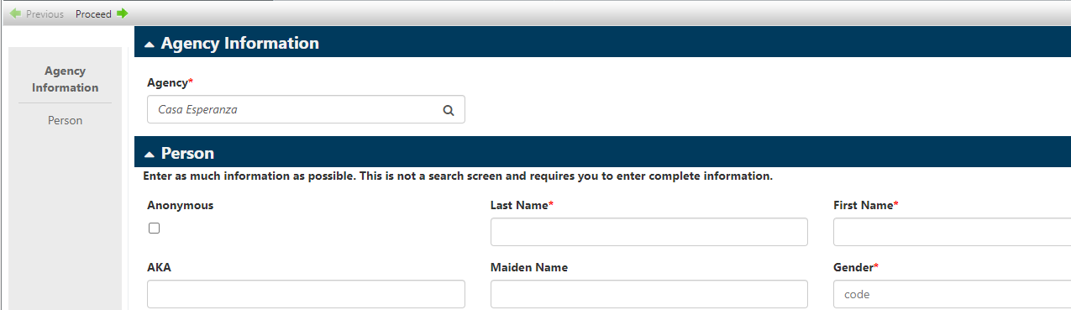
Enrolling Clients in the Group
Add a Client:
1. A pop up box will appear. Enter the Name & Gender (starred fields) of the client you want to add to the group, then click “PROCEED” (in top left corner)

Slide 40
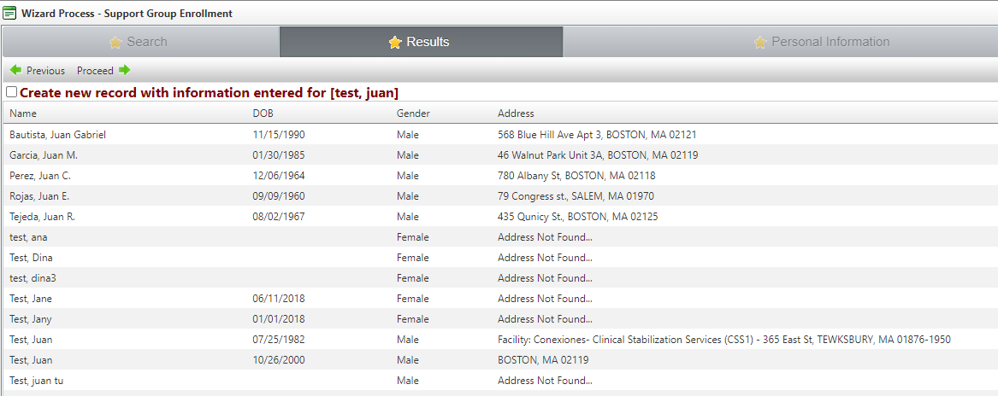
Enrolling Clients in the Group
Add a Client:
Evolv will search for your client. Check to see if the client is within the list. When you find the name, click on it & click “PROCEED” (in the top left corner)
This will bring you to the new Group Enrollment Form.
Click “Proceed”

Slide 41
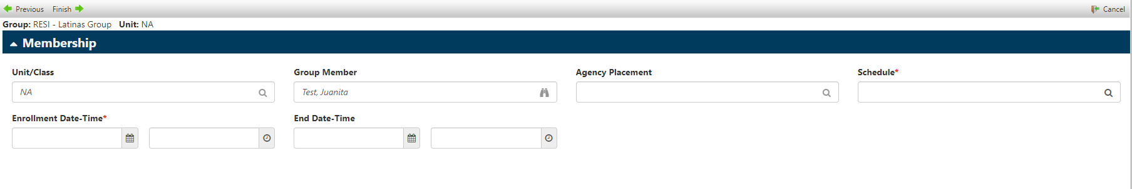
Enrolling Clients in the Group
Add a Client:
The Group Membership form will pop up.
Click on the magnifying glass under “Schedule”. Then click your group.
Fill in the enrollment date & time according to when the client attend the group for the first time.

Slide 42
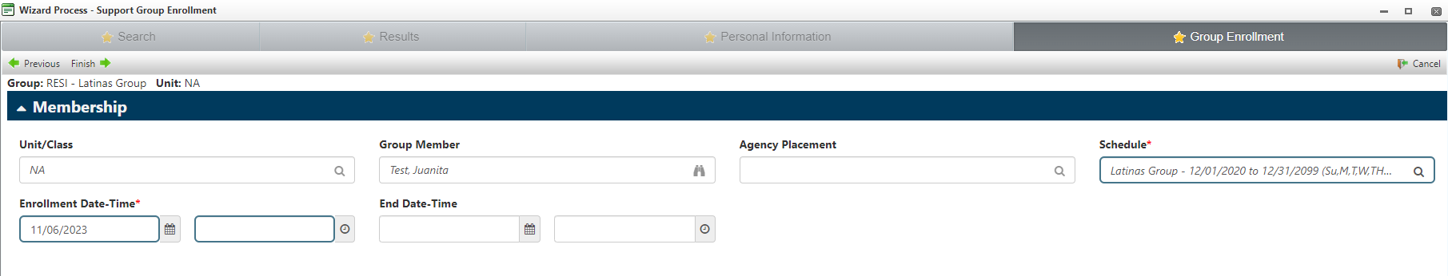
Enrolling Clients in the Group
Add a Client:
Click FINISH at the top to save.
Your client should now appear in the list of enrollees.

Slide 43
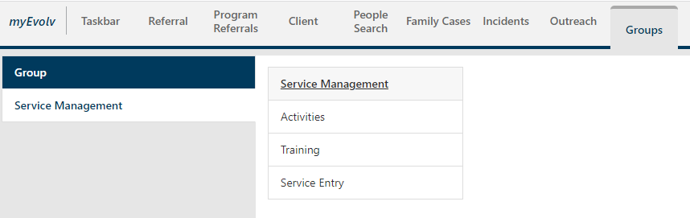
Entering Group Notes
Once you have facilitated a group, you must enter a group note.
Step 1: Go to the Groups Module
Step 2: Click Service Management
Step 3: Click Service Entry

Slide 44
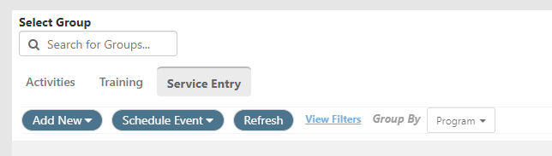
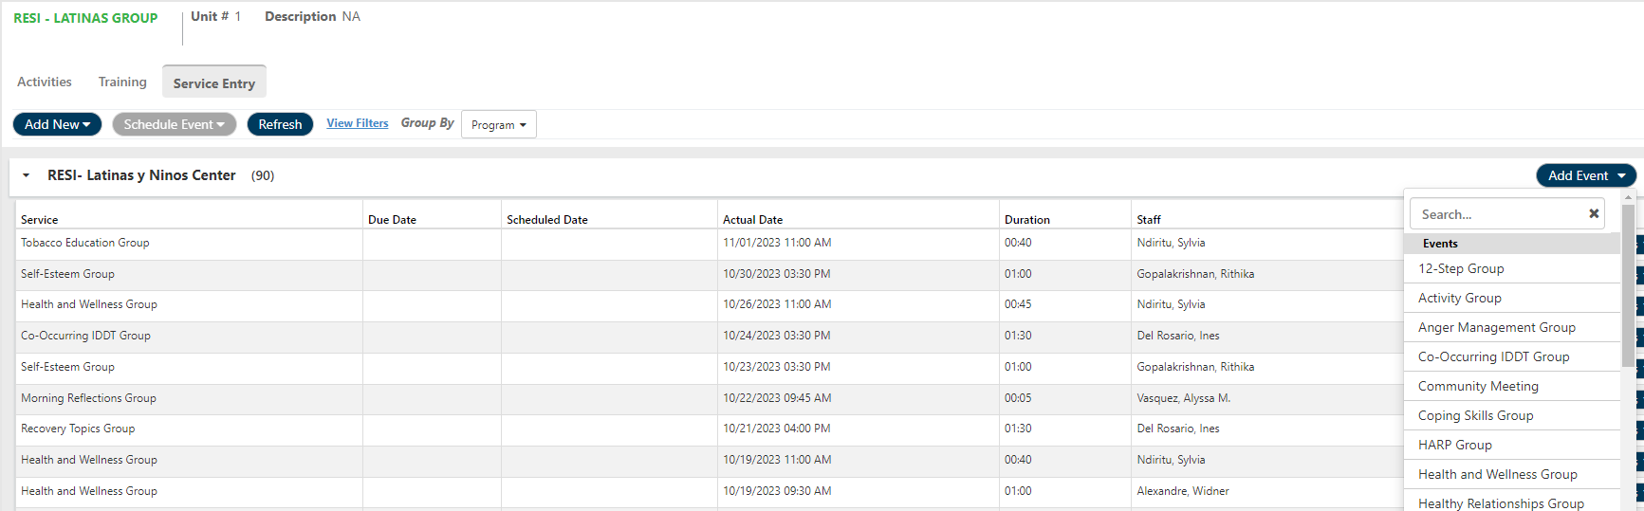
Entering Group Notes
Once you have facilitated a group, you must enter a group note.
Step 4: Select Group
Click “Add Event”

Slide 45
Entering Group Notes
Select the specific group you led from the drop down, e.g., “Community Meeting” or “Health & Wellness Group”

Slide 46
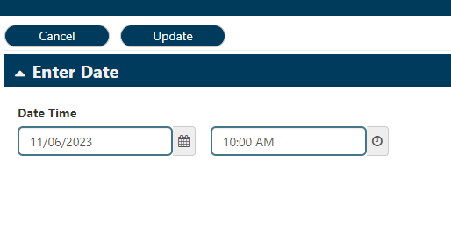
Entering Group Notes
A new pop-up window will appear
Enter the following fields into the form:
  Date & Time of group
  Then, click “Update”
  A new pop-up form will open

Slide 47
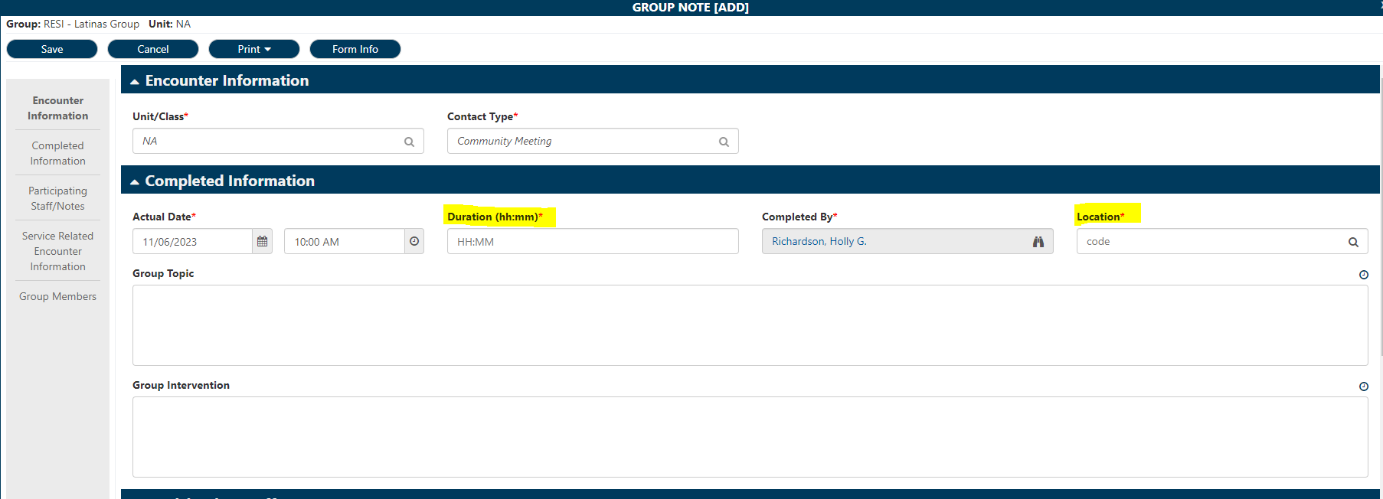
Entering Group Notes
Complete the red starred fields:
  Duration & Location

Slide 48
Entering Group Notes
Complete the Group Topic field with the Topic of your group
Complete ethe Group Interventions field with the specific interventions you used in the group
  Example 1: MAT Education Group
    Group Topic: Suboxone
    Group Interventions: Provided psychoeducation on use of suboxone; facilitated discussion on stigma around MAT
  Example 2: Recovery Goals Group
    Group Topic: Relationships
    Group Interventions: Led exercise about what clients would like from their relationships; facilitated supportive discussion among participants

Slide 49
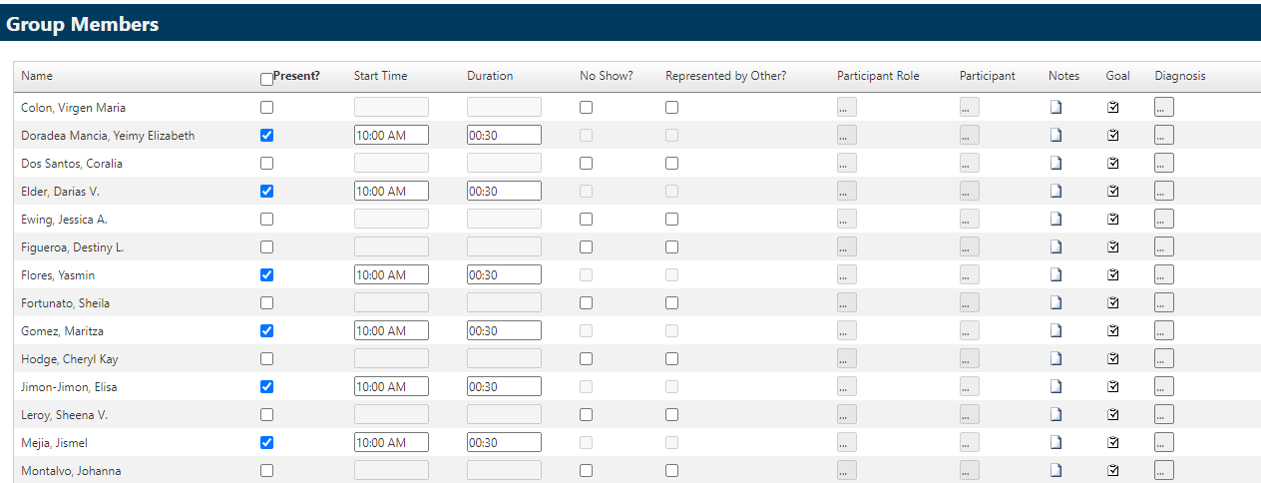
Entering Group Notes
Enter Individual Participant Notes:
  Scroll down to the “Group Members” section
  Everyone who is enrolled in that group should appear
  For everyone who attended the group, click the checkbox next to their name under present
  Ensure duration of group is listened within duration field. If necessary, adjust the duration that an individual was present

Slide 50
Entering Group Notes
Enter Individual Participant Notes:
To the right of each name, click on the notepad icon in the “Notes” column

Slide 51
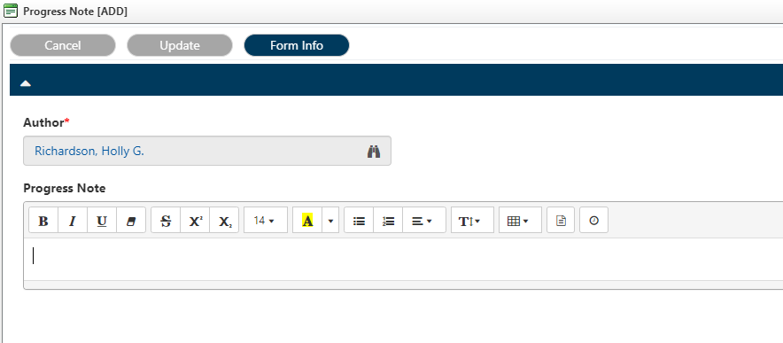
Entering Group Notes
Enter Individual Participant Notes:
Click the Template button to select the Group Note template

Slide 52
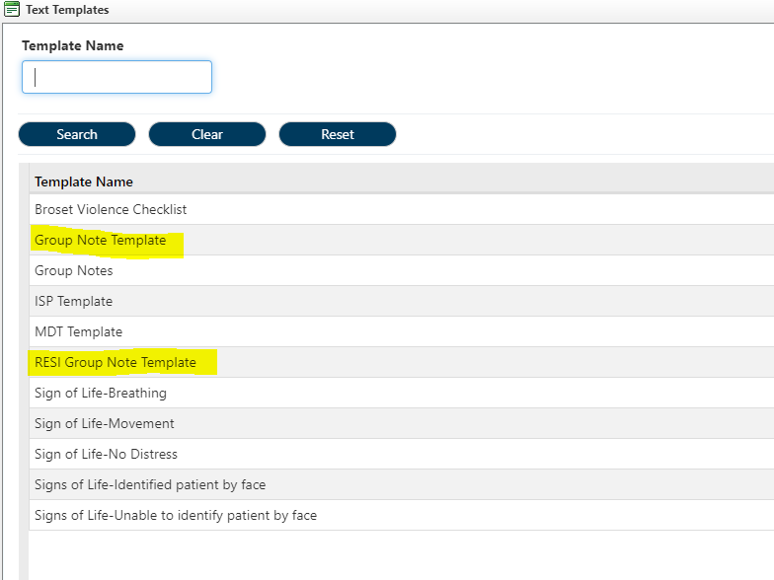
Entering Group Notes
Enter Individual Participant Notes:
Click the Template button to select the Group Note Template

Slide 53
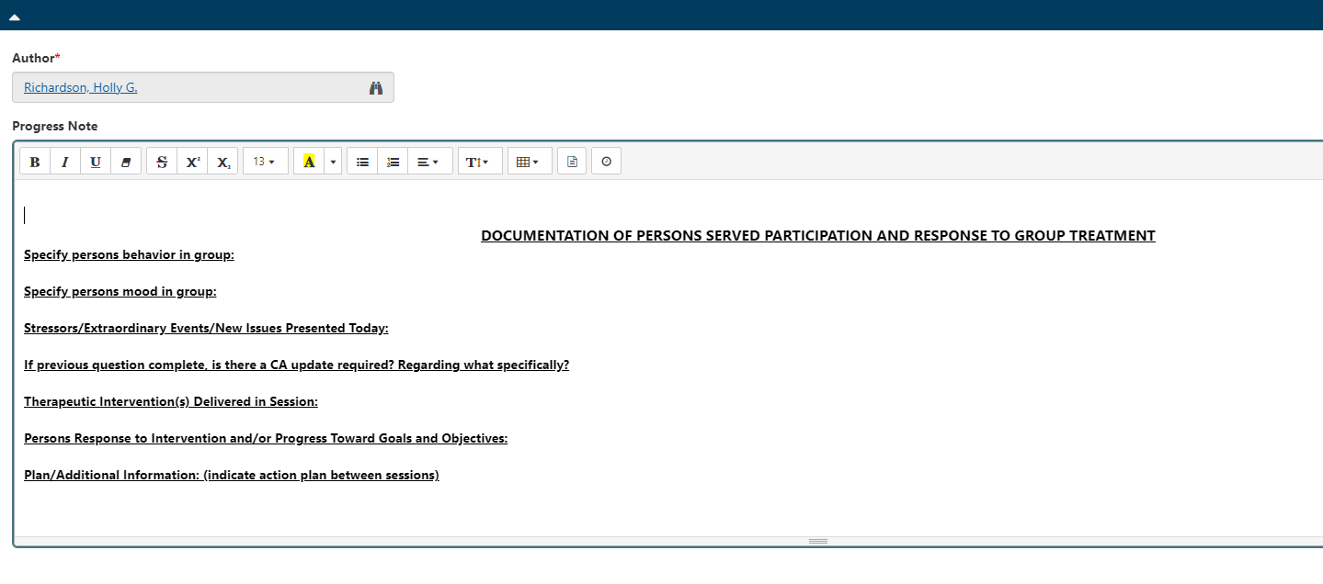
Entering Group Notes
Enter Individual Participant Notes:
Complete the template that populates for that individual note

Slide 54
Entering Group Notes
Enter Individual Participant Notes:
Use one or more of these descriptions to record client’s participation:
  Active participant
  Quiet but engaged
  Not participating
  Disruptive
  Withdrawn
  Showed interest
  No apparent interest
  Showed insight
  Showed leadership

Slide 55
Entering Group Notes
Enter Individual Participant Notes:
Here are some examples of ways you might record Concerns & Follow-up for an individual participant:
  No concerns
  Patient appeared very depressed. Talked to his treatment coordinator.
  Patient was angry and disruptive. Fetched Program Director, who asked her to leave the group.
  Patient expressed suicidal thoughts. Asked him to stay after group and fetched Clinical Supervisor to assess.

Slide 56
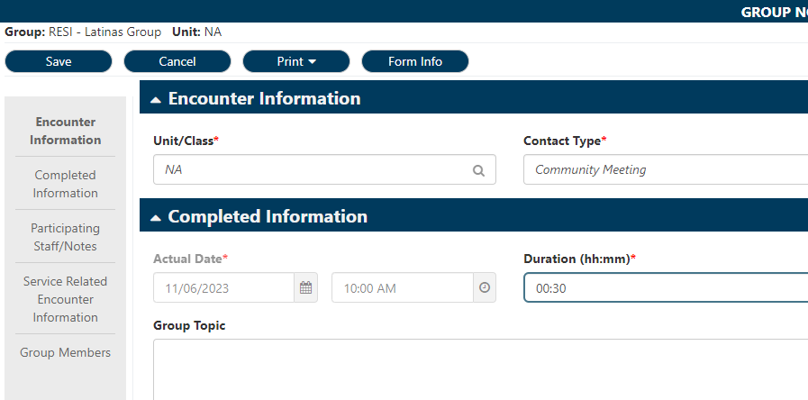
Entering Group Notes
Once you have entered notes for all participants, click “SAVE”
If you don’t have time to complete all the notes in the same session, you can save and go back later to finish the rest.

Slide 57
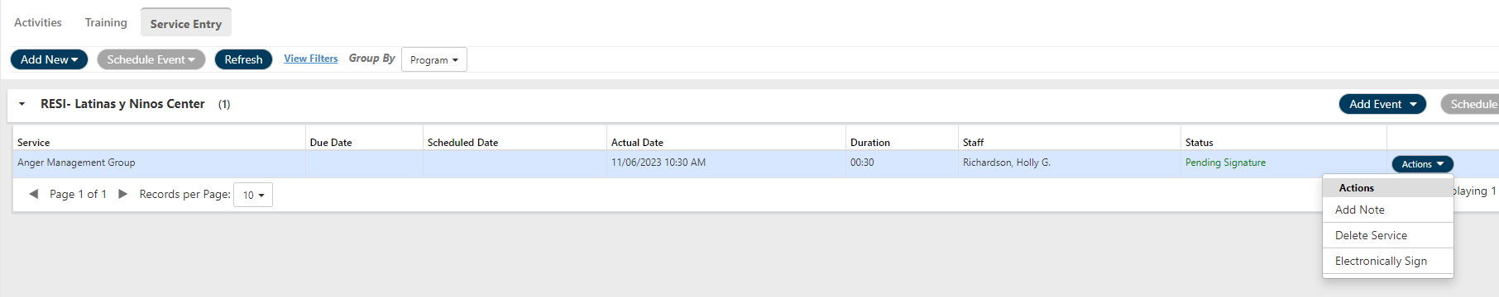
Entering Group Notes
Sign & Submit:
Once you finish & saved all the client notes, the group should appear in the list, along with the name of the group, date performed, duration, and your name.
Click the “ACTIONS” button to the right of the information & Click on “Electronically Sign”

Slide 58
Entering Group Notes
Sign & Submit:
This action will electronically sign every note that goes into the individual client charts
Once you electronically signed the group, you will notice the status change from “Pending Signature (in green)” to “Signed (in blue)”.
By electronically signing the group, it automatically submits the service for review

Slide 59
Skills Practice
In Development, practice enrolling a client in the RESI-Men’s Group
Practice entering a note for an Anger Management Group

Slide 60
Discussion: What Groups?
Overdose Prevention Education
Recovery Goals Group
Phase Group
Life skills
Program Orientation
Just for Today
Daily Reflection
Stages of Change
Coping Skills
Self-Esteem
Health and Wellness
Medication Management
MAT Education
Relapse Prevention
Post-Acute Withdrawal Symptoms
HARP
Double Trouble
Helping Men Recover
Helping Women Recover
Solutions Focus
Anger Management
Thinking for a Change
Nutrition Program
Healthy Relationships
HIV Prevention Group
Housing 101 Group
Domestic Violence Education
Reproductive Health Education

Slide 61
New Phase Enrollment
When a patient is ready to change phase, remember to end the old phase and enter the new phase within Evolv
Patient’s phase will pull into many other forms, including Progress Notes and Treatment Plan

Slide 62
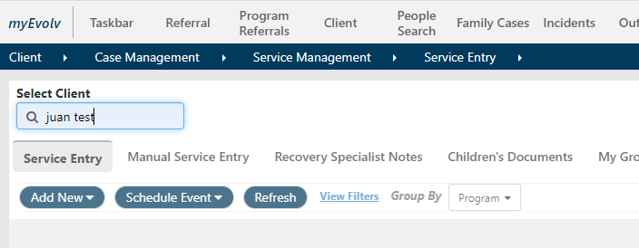
Phase Enrollment
Follow the breadcrumb below & select your client:

Slide 63
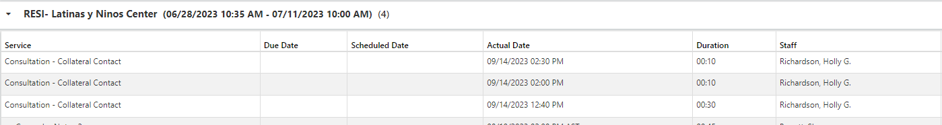
Phase Enrollment
Locate your Program:
Find & open the patient’s current Phase Form
Enter an end date & save the form

Slide 64
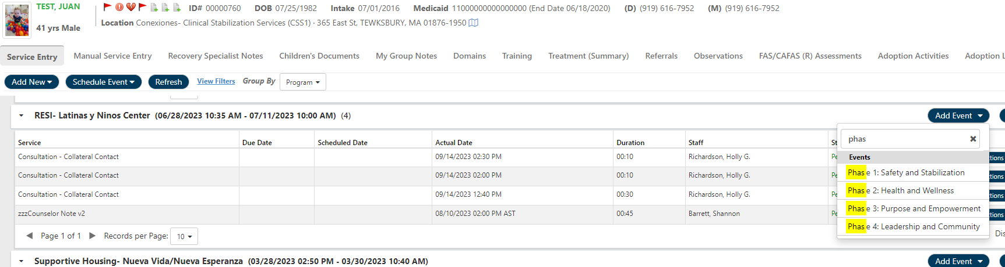
Phase Enrollment
Click the “ADD EVENT” button associated with your program
Select Phase 2, 3, or 4 depending on the next phase for the patient

Slide 65
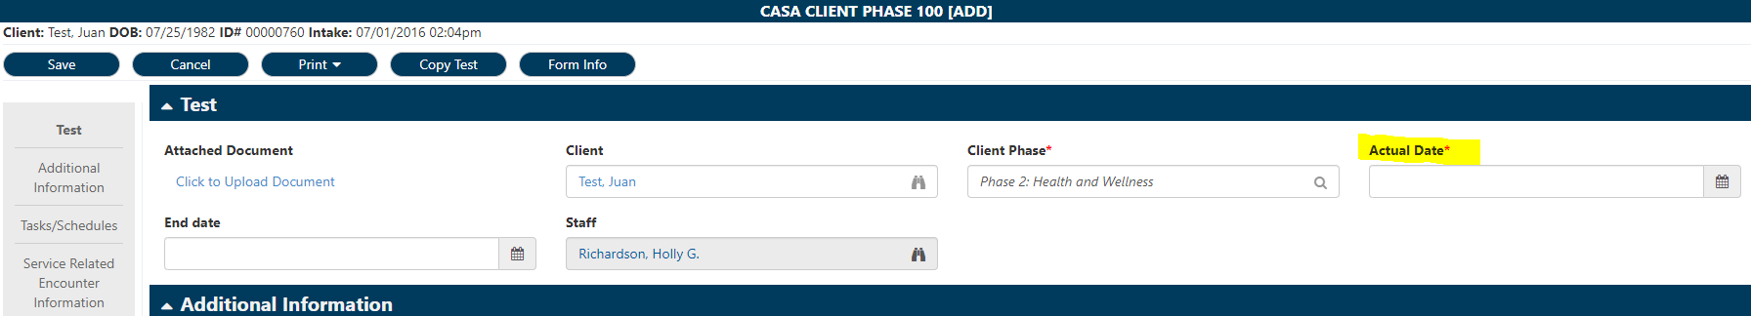
Phase Enrollment
Complete the “Actual Date” field, and save the form

Slide 66
Treatment Plan Review
When the patient is ready for a Treatment Plan Review, complete this in Plan Development
This process may connect with MDT Presentation, ASAM, and Reauthorization

Slide 67
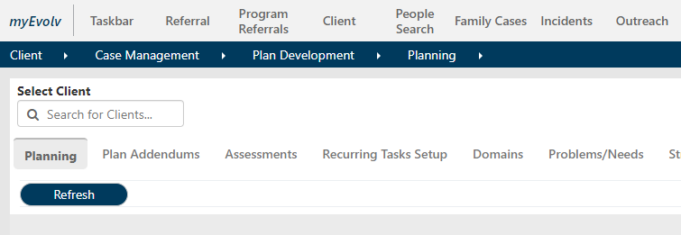
Treatment Plan Review
Follow the below breadcrumb
Search for, and select your client

Slide 68
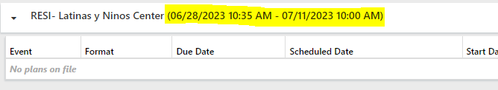
Treatment Plan Review
When you click on “Planning” you will see the list of Programs the client has been enrolled in at CASA in the past & currently.
  From & To Dates show when the patient enrolled and/or discharged from each program
Click the Link for Treatment Plan Review:

Slide 69

Thank you!
Questions?
Test/Survey link on next slide
If you don’t complete the test, you were not present!

