Slide 1

Residential Programs
Referral Chart Forms
Facilitators: Jessica Evans and Jane Keat

Slide 2

Training Housekeeping
We help each other grow
    Speak from your experience
    Accept constructive criticism with grace
    Respect each other
Let’s not interrupt our learning experience
    No side conversations
    Keep the microphone on mute unless speaking
Be here now
    Participants are highly encouraged to be on video
    Minimize “coming and going” during the training
    Take care of yourself
    5-minute break will occur ~ 10 AM
*Fill out the quiz at the end of the presentation, it will be used to keep attendance*

Slide 3

GOALS & OBJECTIVES
Goal: For staff to become familiar with how to process a Residential referral, using the new workflow, new forms, and the Evolv system.
Objectives:
At the end of the training, participants will:
  • Become familiar with the Residential Referrals Workflow
  • Understand the purpose of the new application and phone screen
  forms
  • Understand how to find the Evolv forms used during the Referral
  process
  • Have practiced using the Evolv Referral Forms
Notes:
Not included in the powerpoint

Slide 4

CASA POLICIES
All Casa training is based on carefully reviewed and approved policies and procedures. We will not have time to discuss suggestions or recommendations for changes to policies during this training. If you would like to request a change, please submit your proposal in writing to your supervisor, who will review it and bring it to Senior Leadership for discussion. Any changes to a policy will be distributed via email to all staff.

Slide 5
CASA POLICIES
Casa Esperanza has a set of Clinical Policies and Procedures that pertain to all clinical programs, including Residential, Outpatient and CSS.
The document is called CEI_PoliciesandProcedures and is saved in the G Drive
  Residential Programs
  Current Residential Forms
  Casa Esperanza Clinical Policies & Procedures
Section 2 of the Manual includes Policies and Procedures about referral to the program

Slide 6
REVIEW
• New tools and workflows to help staff:
  • Conduct thorough assessment of each patient’s risk and resiliency in multiple domains upfront
  • Collaborate and communicate within Integrated Care Team to develop and implement Integrated Care Plan for each patient
  • Conduct trauma-informed, stagewise safety planning and ongoing safety monitoring
  • Provide patient-centered, trauma-informed care that supports treatment plan objectives and matches patient’s stage of change
  • Think through crises in safety-focused, trauma-informed way to reach best possible clinical judgment in response

Slide 7
BACKGROUND
• Remember: using Evolv involves doing things differently; some forms and steps are changing
• Opportunity for broader change:
    More thorough assessment upfront
    Increased collaboration with Outpatient
    More transparent, trauma-informed engagement with patients around program expectations and safety planning
    Strengthening use of Phases in treatment to match patient’s stage of change
• As we learn steps, will also start to map process—who, what, when, where, how (Process Mapping)

Slide 8
SAFETY
Referral stage: Laying Foundation for SAFETY
Throughout this process, ask:
  What are the possible risk issues with this patient?
  Suicidality?
  Homicidality or violence?
  Sex offending history?
  Fire-setting history?
  Domestic violence/restraining order issues?
  Ethical/legal issues?
• Is Residential the right Level of Care for this patient?
• Can we provide this patient with what they need to be safe?

Slide 9
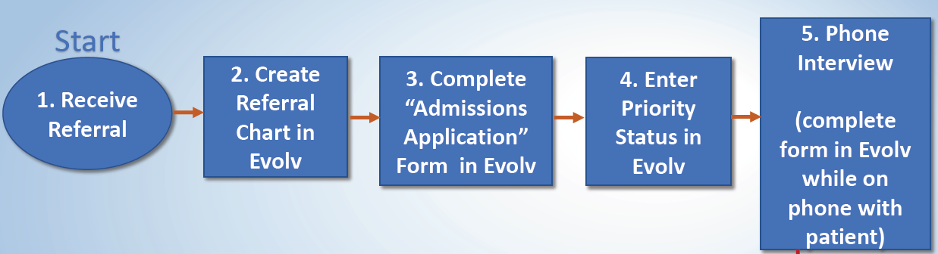
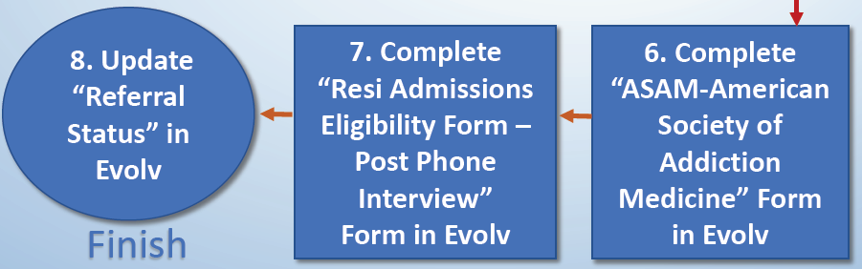
WORKFLOW FOR REFERRAL CHART

Slide 10
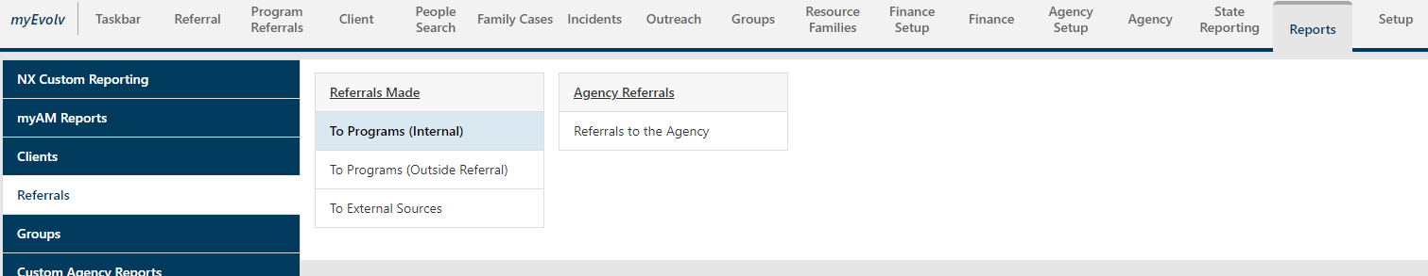
WORKFLOW STEP 1: RECEIVE REFERRAL
1. Check for new referrals to the program
  a) Email
  b) Fax
  c) Run “Internal Referrals” report in Evolv

Slide 11
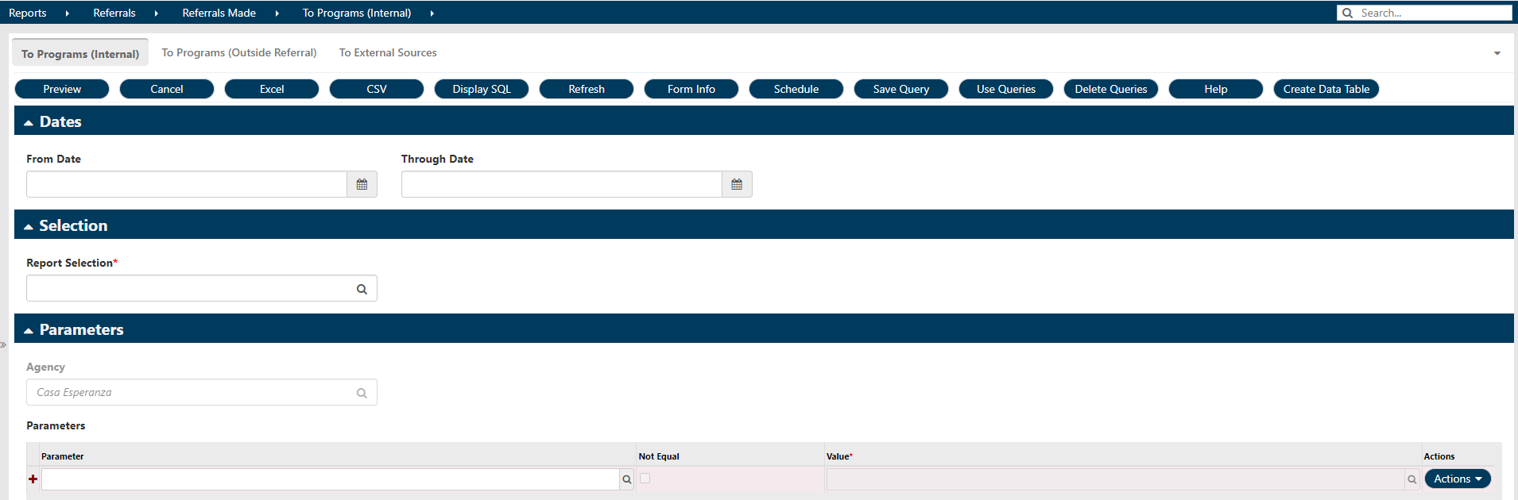
WORKFLOW STEP 1 CONTINUED REFERRAL REPORT
  Enter the fields:
      § Dates: Enter the appropriate date range
      § Report Selection: Ordered by Program Referred to
      § Parameter: Program
      § Value: Select your program

Slide 12
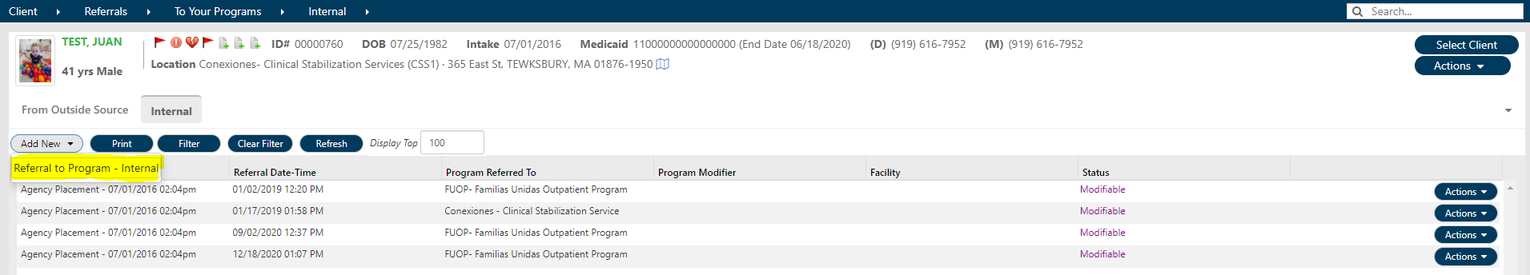
WORKFLOW STEP 2: CREATE REFERRAL CHART IN EVOLV
1. Check to see if there is an existing chart in the system for the applicant
  a. If there IS a chart in the system,
    i. Add a new “Internal Referral” by going to
    ii. Click on “Add New” Click “Referral to Program - Internal”
  b. If there is NOT a chart in the system,
    i. Create a new Referral Chart
    ii. Follow instructions in the “How to Create a Referral Chart” Training

Slide 13
RESI ADMISSIONS APPLICATION
• Enter key information from paper application into Evolv
• Allows us to
      track referrals
      assess eligibility
      designate priority statuses to manage admissions process
• Allows us to gather data on
      length of time from referral to admission
      who are we turning down and why, etc.
• Everything we enter:
      helps us determine eligibility and priority status
      populates other areas of patient’s chart

Slide 14
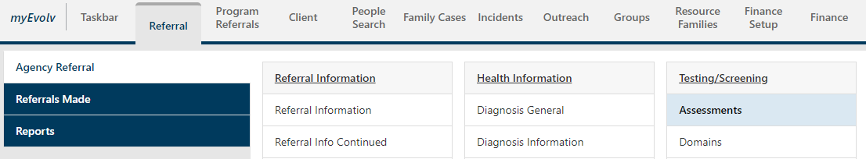
WORKFLOW STEP 3: ADMISSIONS APPLICATION IN EVOLV
How to Get to the Residential Admissions Application Form:
1. Click on the “Referral”
2. Click on “Agency Referral”
3. Scroll to the right to “Testing/Screening”
4. Scroll down, Click on “Assessments”

Slide 15
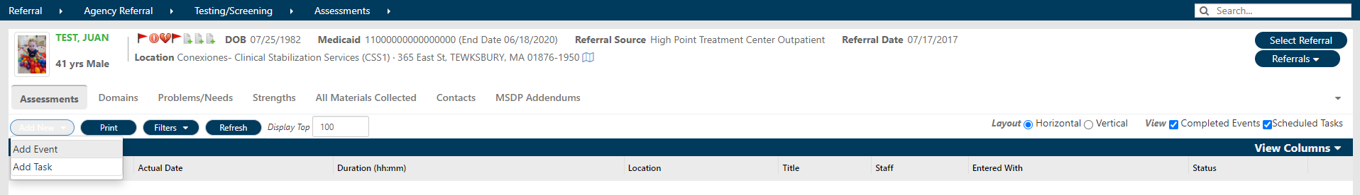
WORKFLOW STEP 3: ADMISSIONS APPLICATION IN EVOLV
How to Get to the Residential Admissions Application Form:
1. Click “Add New”, “Add Event”

Slide 16
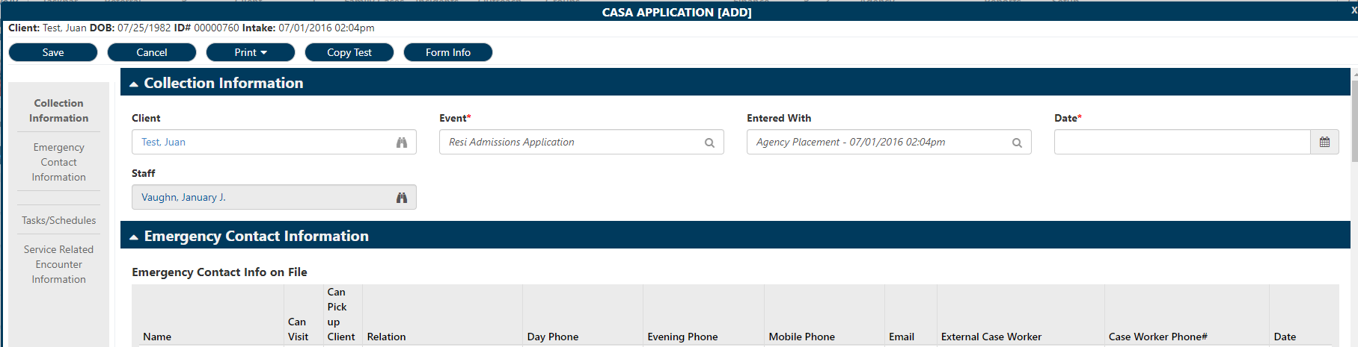
RESI ADMISSIONS APPLICATION
1. Complete the form and click “Save”
2. Once the form is saved, click “Submit”
Once the form is saved, it will show up under “Manual Service Entry”

Slide 17
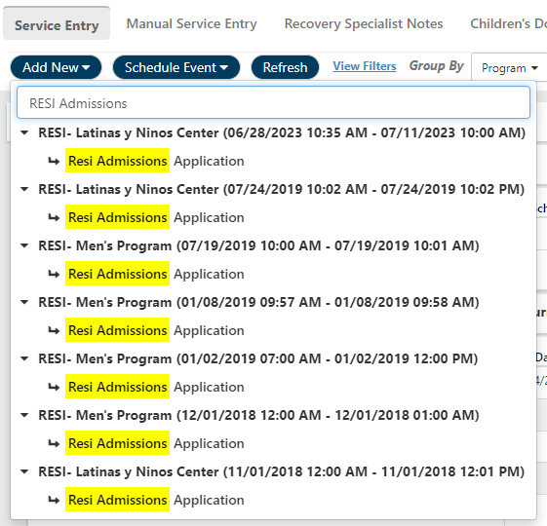
WORKFLOW STEP 3: ADMISSIONS APPLICATION IN EVOLV
1. Click on “Add New”
  a) Type in and Select “Resi Admissions Application”

Slide 18
LIVE EXAMPLE
Now we will go to the
Resi Admissions Application in Evolv
Referral > Agency Referral > Testing/Screening > Assessments

Slide 19
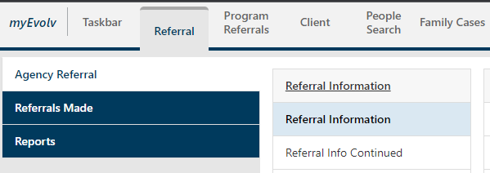
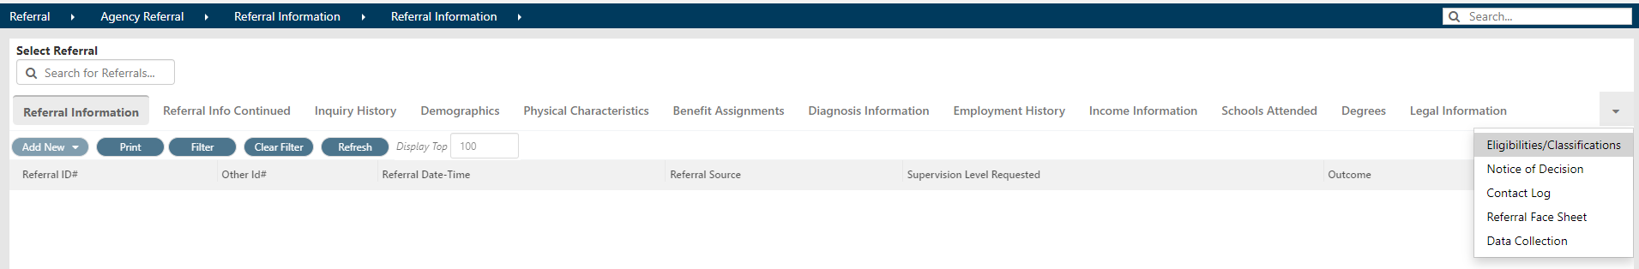
WORKFLOW STEP 4: ENTER PRIORITY STATUS IN EVOLV
1. Click on “Referral"
2. Click on “Agency Referral”
a) Search for and select the correct client chart
3. Click on “Referral Information”
a) Select “Eligibilities/Classifications” from the drop-down menu/carrot on the right

Slide 20
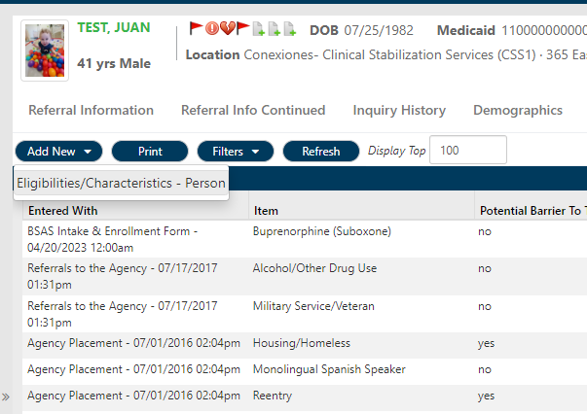
WORKFLOW STEP 4: ENTER PRIORITY STATUS IN EVOLV
4. Click on “New Manual Event”
  a) Select “Eligibilities/Characteristics
  – Person”

Slide 21
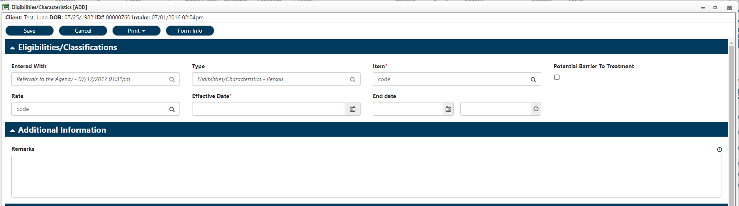
WORKFLOW STEP 4: ENTER PRIORITY STATUS IN EVOLV
5. Enter applicable data into the form
  a) Click on “Item”
i. Select the appropriate Priority Status
  b) Effective Date: Enter the current date
  c) Remarks: You have the option to enter
  additional comments if necessary
6. Click “Save”

Slide 22
PHONE INTERVIEW
Purpose of the Phone Interview is to:
  • Explain the program structure and policies to the patient, so they can decide whether they want to participate;
  • Help us find out more about the patient to decide whether
  Residential is the right level of care for them; and
  • Identify any specific risk issues that might mean we cannot safely care for this patient.

Slide 23
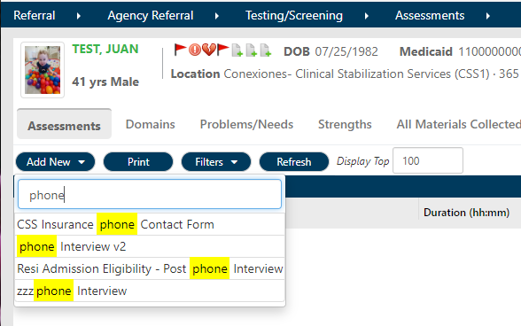
WORKFLOW STEP 5: PHONE INTERVIEW
1. Click “Referral”
a) Search for and select the correct chart
3. Click “Testing/Screening > Assessments”
4. Click “New Manual Event”
a) Select “Phone Interview”
5. Complete all fields, then click “Save”
6. Once the form is saved, click the “Submit”

Slide 24
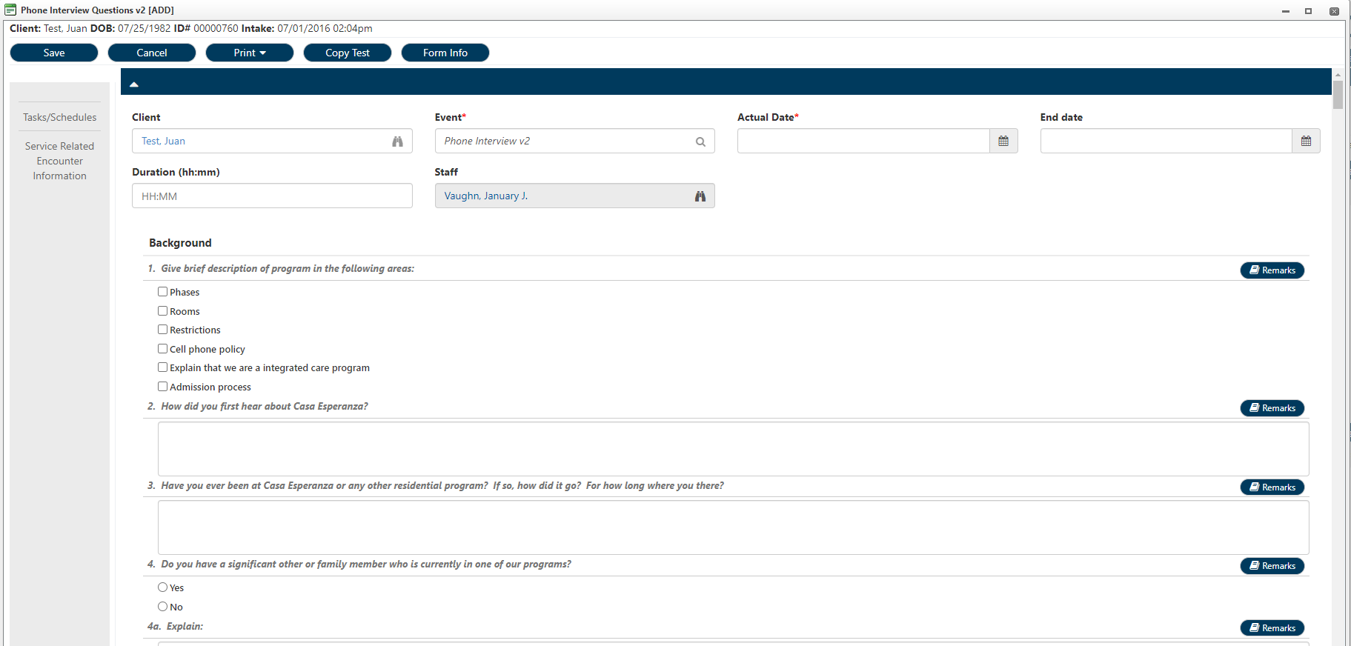
PHONE INTERVIEW

Slide 25
LIVE EXAMPLE
Now we will go to the
Phone Interview form in Evolv
Referral > Agency Referral > Testing/Screening > Assessments

Slide 26
PHONE INTERVIEW
1. Before you call the patient, open the Phone Interview form
2. Select today’s date
3. Start the interview by building rapport with the patient and describing the program to them
4. Then ask the first questions, which are background questions, and record the answers briefly

Slide 27
PHONE INTERVIEW
• Medical
  Identify any medical concerns that mean this program cannot safely care for this patient
  Confirm Medications and Allergies
  Identify providers
• Mental Health
  Identify any mental health concerns that mean this program cannot safely care for this patient
  Ask about suicidal and homicidal thoughts and actions
  Consult with Program Director or Clinical Supervisor before ending the call if patient reports suicidal or homicidal thoughts

Slide 28
PHONE INTERVIEW
• Substance Use
  Confirm substance use and other addictive behaviors
  Identify treatment and recovery experiences
• Income
  Clarify sources of income and any rep payee arrangements
• Legal Issues
  Identify any legal issues that may affect patient’s participation in program
• Family Issues
  Identify any family issues that may affect patient’s
  participation in program

Slide 29
ACTIVITY
In your Break-out groups – Practice concurrent documentation
1. Choose an Interviewer and an Interviewee
2. The Interviewer will open a Word document on their own computer and do a brief interview with the Interviewee:
  Do you have any pets?
  What is your favorite color?
  Where is your favorite place in the world?
  Etc.
3. The Interviewer will type the answers into the Word document as they have the conversation
4. After 5 minutes, change roles around in the group.

Slide 30
NEXT STEPS
• After the Phone Interview
• Program Director reviews Application and Phone Interview
• Completes the ASAM
• Determines whether patient is eligible and can be admitted using Resi Admission Eligibility Form
(Note: On day of admission, ASAM and Eligibility will be repeated—different Eligibility Form)

Slide 31
ASAM
Purpose of the ASAM is to:
• Identify the appropriate level of care for a patient
Important to complete ASAM before Admission to check our thinking about patient
Remember: whole referral process = laying foundation for safety

Slide 32
ASAM
Six Dimensions:
1. Intoxication/Withdrawal Potential
2. Biomedical Conditions
3. Emotional/Behavioral/Cognitive Conditions
4. Readiness to Change
5. Relapse Potential
6. Recovery Environment & Living Situation

Slide 33
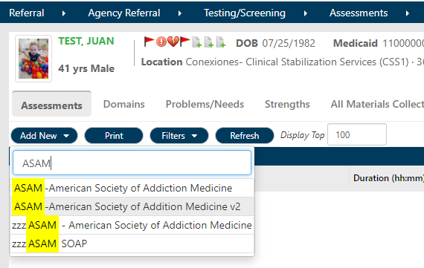
WORKFLOW STEP 6: COMPLETE ASAM FORM IN EVOLV
Click “Referral”
Click on “Select Referral”
a) Search for and select the correct chart
3. Click on “Testing/Screening > Assessments”
4. Click on “New Manual Event”
a) Select the current version of the “ASAM – American Society of Addiction Medicine”

Slide 34
LIVE EXAMPLE
Now we will go to the
ASAM - American Society for Addiction Medicine form in Evolv
Referral > Agency Referral > Testing/Screening > Assessments

Slide 35
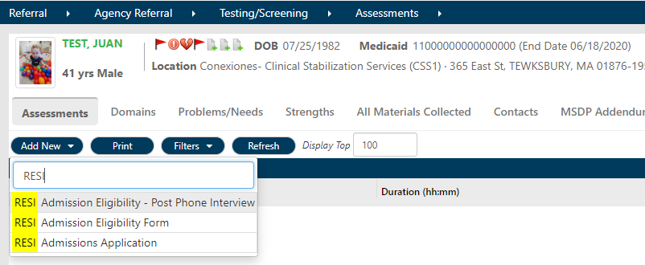
WORKFLOW STEP 7: RESI ADMISSIONSELIGIBILITY – POST PHONE INTERVIEW
1. Click on “Select Referral”
a) Search for and select the correct chart
2. Click on “Testing/Screening > Assessments”
3. Click on “New Manual Event”
a) Select “Resi Admissions Eligibility-Post Phone Interview”

Slide 36
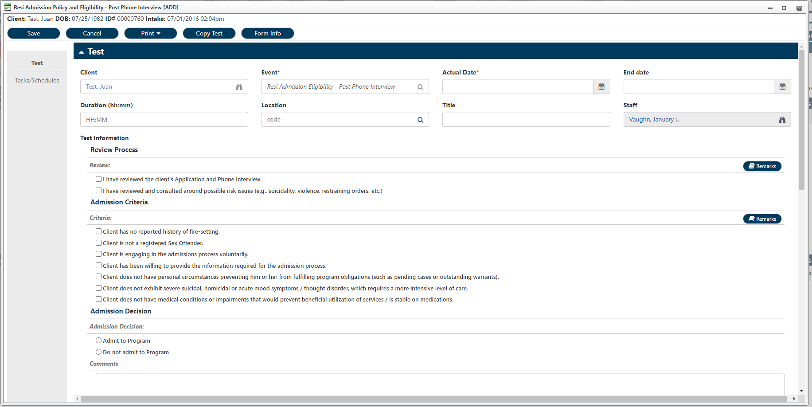
WORKFLOW STEP 7: RESI ADMISSIONSELIGIBILITY – POST PHONE INTERVIEW

Slide 37
NEXT STEPS
• After the admission decision is made
• Update Referral Status to Accepted, Denied, or Withdrawn
• Make appointment for intake and admission

Slide 38
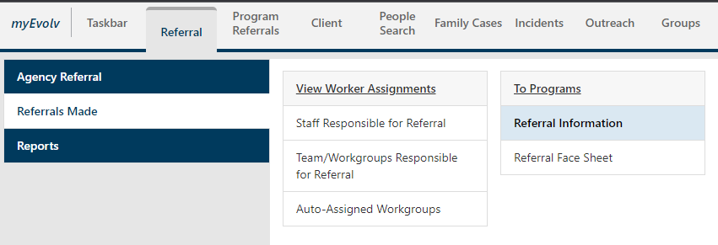
WORKFLOW STEP 8: UPDATE “REFERRAL STATUS” IN EVOLV
1. Click “Referral”
a) Search for and select the correct chart
2. Navigate to
Referrals > Referrals Made > To Programs > Referral Information

Slide 39
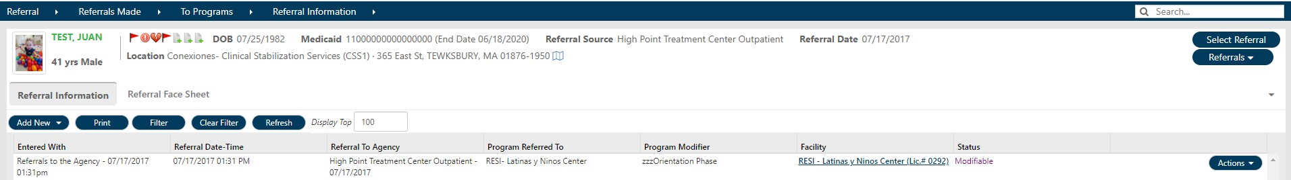
WORKFLOW STEP 8: UPDATE “REFERRAL STATUS” IN EVOLV
This page is where you will find record of referrals to internal programs
1. Locate the referral to your program
a) Example: RESI – Men’s Program

Slide 40
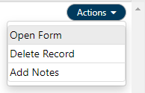
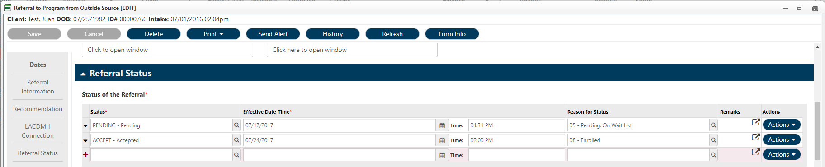
WORKFLOW STEP 8: UPDATE “REFERRAL STATUS” IN EVOLV
1. Click “Actions”
2. Click “Open Form”
3. Scroll down to “Referral Status”
  a) DO NOT CHANGE THE EXISTING STATUS
    b) On the next line add
      i. Status
      ii. Current Date and Time
      iii. Reason for Status

Slide 41

ACTIVITY
Practice logging in to Evolv
1. Open Evolv from the desktop icon
2. Change the URL
a) Add the letters “dev” into the URL
            https://myevolvcespdev.netsmartcloud.com/Login.aspx
3. Enter your login name and password
4. Return to the Zoom training and report if you were able to sign in or not.

Slide 42

Thank you!

