Slide 1

Discharge
Facilitators: Jany Keat & Jessica Evans

Slide 2
Goal & Objectives
Goal: The Goal for this training is for staff to become familiar with the tools used in Evolv around discharging a patient.
Objectives:
At the end of this training, participants will:
Understand the role of safety in planning for discharge
Know how to access and enter a Discharge Summary for a patient
Know how to end a patient enrollment in Evolv

Slide 3
Background
Remember: using Evolv involves doing things differently; some forms and steps are changing
Opportunity for broader change:
  More thorough assessment upfront
  Increased collaboration with Outpatient
  More transparent, trauma-informed engagement with patients around program expectations and safety planning
  Strengthening use of Phases in treatment to match patient’s stage of change
As we learn steps, will also start to map process—who, what, when, where, how

Slide 4
Review: Principles of Social Justice & Trauma-Informed Care
Safety | Collaboration & Mutuality
Trustworthiness & Transparency | Empowerment, Voice & Choice
Self-Awareness & Self-Regulation | Racial, Cultural & Gender Equity
Equitable Leadership & Participation

Slide 5
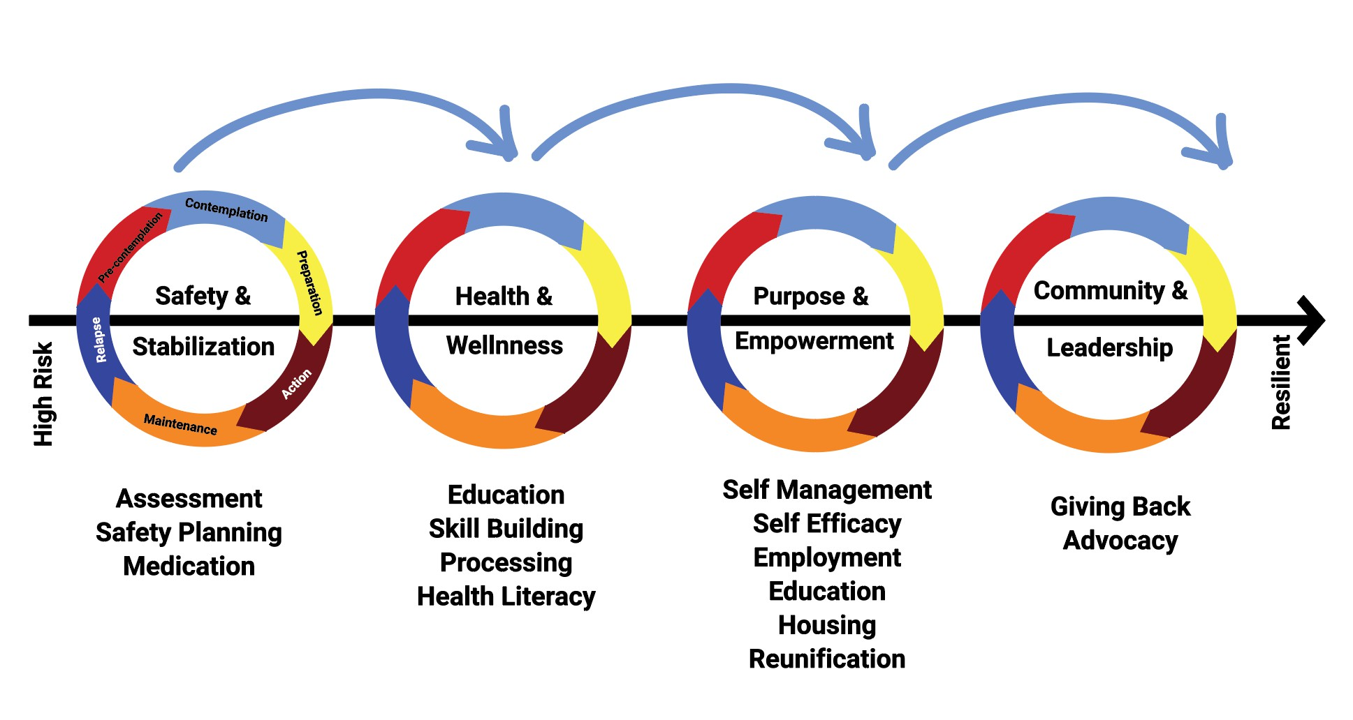
Phases of Treatment

Slide 6
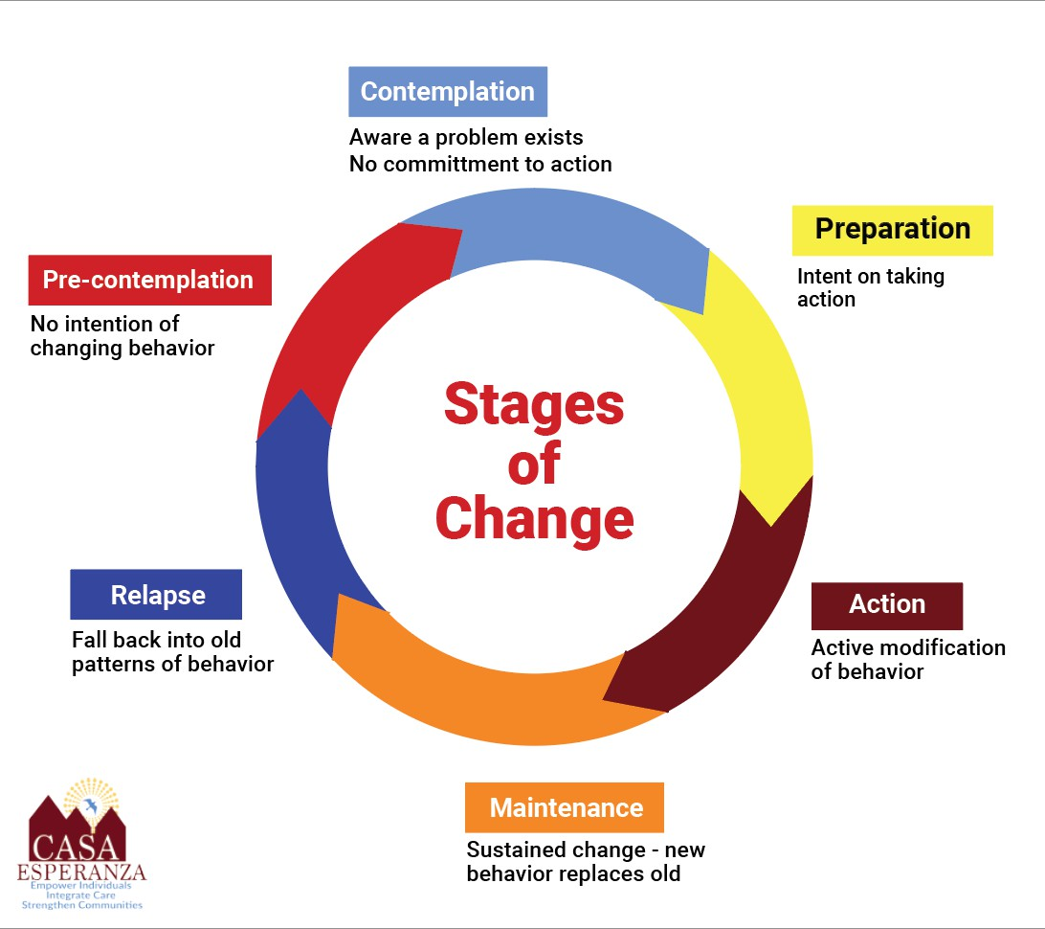
Stages of Change

Slide 7
Reasons for Discharge
Many possible reasons for discharge:
Dropout
Administrative discharge
Transfer to a more appropriate level of care
Medical hospitalization
Successful completion of treatment
…

Slide 8
Safety First & Safety Last
Safety always central in preparing for discharge
Even in dropout and administrative discharge situations, conduct safety planning if possible using Aftercare Plan:
  Where will you spend the night?
  How will you look after and take your medications?
  …

Slide 9
Steps to Take at Discharge
Update Aftercare Plan with patient (if possible)
Enter Residential Disenrollment in BSAS/ESM Virtual Gateway
  Must be completed on day of discharge
End patient enrollment in Evolv
  Must be completed on day of discharge
Complete Discharge Summary

Slide 10
1. Update Aftercare Plan
Each tab covers a different domain: Substance Use, Psychological Health, Physical Health, Basic Needs, Legal, Occupational, Social, and Daily Living Related
  Patient’s plan for staying safe and well
  Key contacts
  Enter or review external referrals made

Slide 11
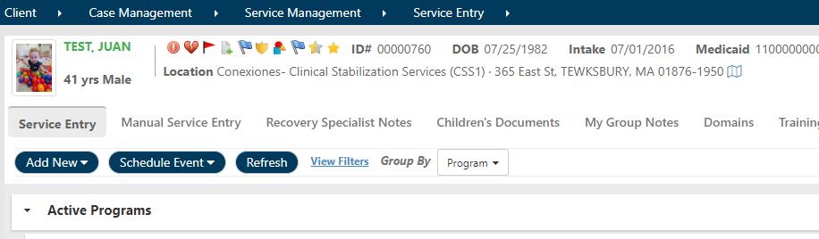
Aftercare Plan
1. Click on “Select Client”
  Search for and select the correct Client chart
  2. Navigate To:

Slide 12
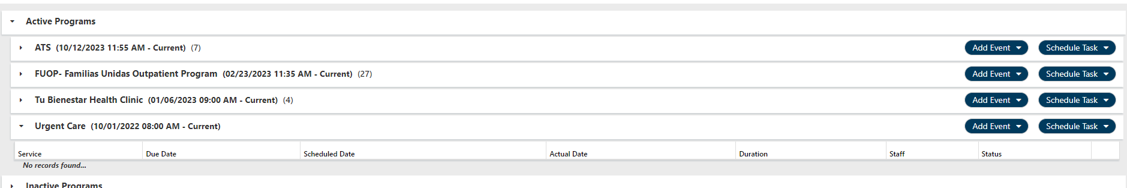
Aftercare Plan
You may see multiple Programs listed.
  These are all Programs that this patient has been enrolled in (in Evolv)
  Some programs in this list will have start and end dates (patient is no longer enrolled in that program)
  Some programs in this list will only have a start date (patient IS currently enrolled in those programs

Slide 13
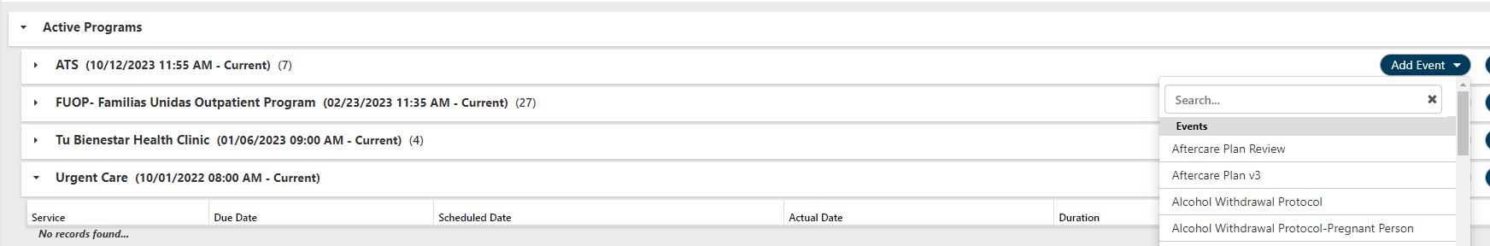
Aftercare Plan
Locate YOUR program
  Click on the “ADD EVENT” button associated with YOUR program
  Select the most current version of the “Aftercare Plan” listed within the events

Slide 14
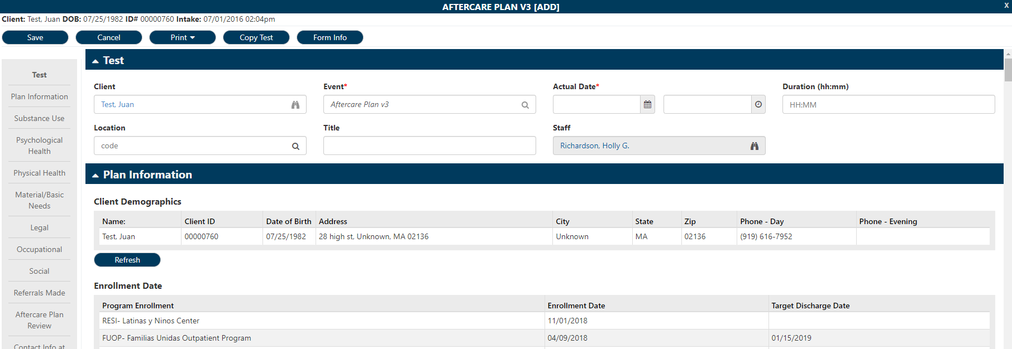
Aftercare Plan

Slide 15
2. Disenroll in BSAS Virtual Gateway
BSAS Residential Disenrollment Assessment asks for:
  Disenrollment reason
  Discharge plan
  Referred to self-help
    Frequency of participation in self-help groups past 30 days
  Employment status
    Number of days worked past 30 days
  Number of arrests past 30 days
  Living arrangements (with special questions if client homeless on intake)
  Substance use past 30 days
  Nicotine use past 30 days
  Repeat Patient Placement Criteria
  BSAS Disenrollment forms are now available in Evolv. Complete the Evolv form & the Virtual Gateway form.

Slide 16
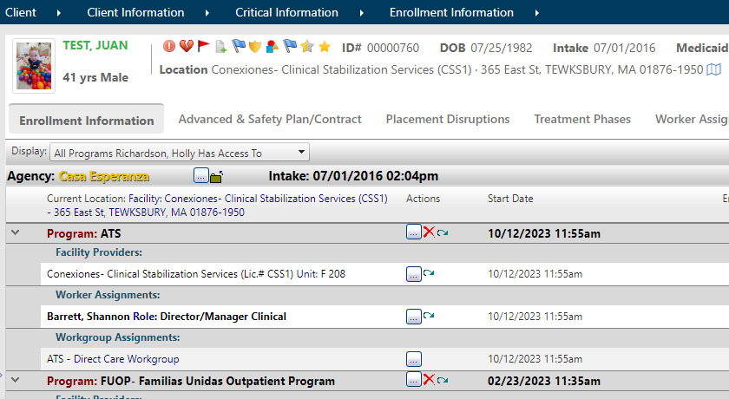
3. End Program Enrollment
The Program Enrollment MUST be ended before the end of business the SAME DAY the patient leaves the program.
Each day this is delayed, insurance will be billed for the patient’s stay at the program – even though the patient is NO LONGER THERE.
Navigate to
Client > Client Information > Critical Information > Enrollment Information

Slide 17
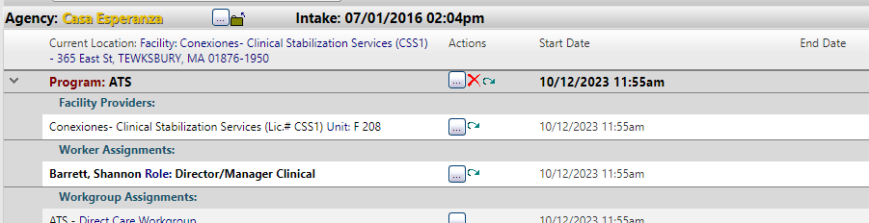
End Program Enrollment
To end the program enrollment
Locate YOUR Program Enrollment Line
Click on the button with three dots to the right of the program name

Slide 18
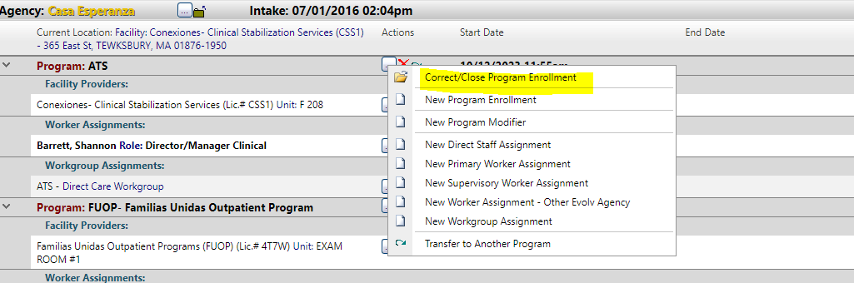
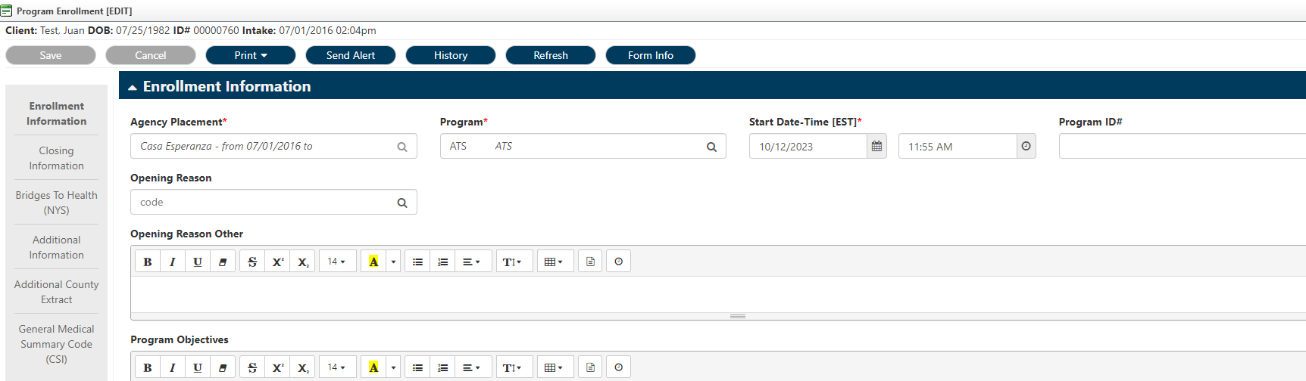
End Program Enrollment
Select “Correct/Close Program Enrollment” from the dropdown
The ‘Program Enrollment’ window will open

Slide 19
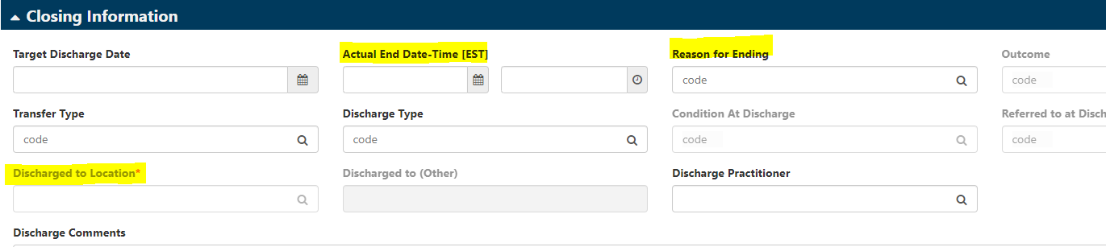
End Program Enrollment
Scroll down to Closing Information at the bottom of the window
Actual Discharge: Enter date and time the patient actually left the program
Reason for Ending: Select the appropriate reason for the patient leaving the program
Discharged to Location: Search for and select the location the patient went to after discharge
Click ‘Save’

Slide 20
Activity
In Development, open a client chart and practice ending an enrollment

Slide 21
4. Complete BSAS Disenrollment/Discharge Form
Summarizes patient’s treatment experience, including:
  Response to treatment
  Progress toward Goals and Objectives
  Referrals made
  Status in key areas on discharge
Includes key information required by BSAS

Slide 22
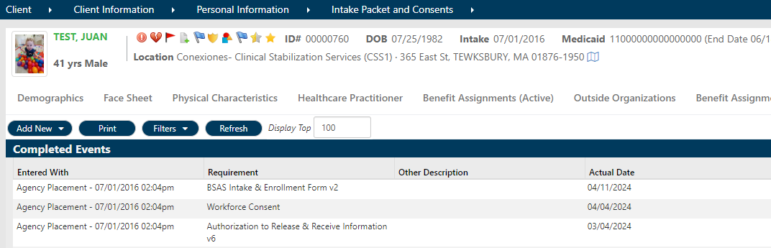
BSAS Disenrollment/Discharge Form
1. Click on “Select Client”
  Search for and select the correct Client chart
  2. Navigate To:

Slide 23
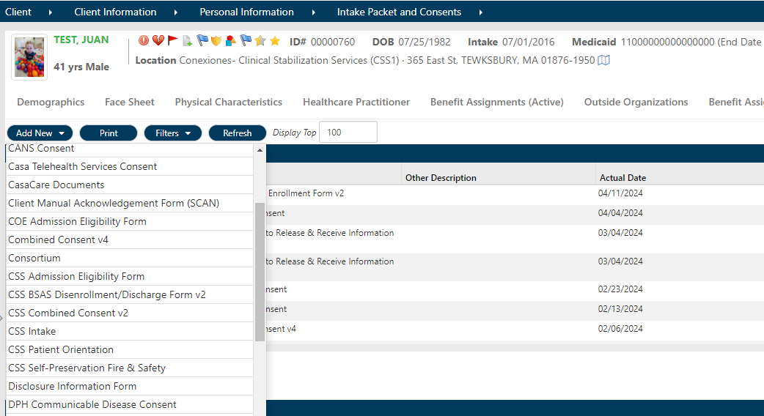
BSAS Disenrollment/Discharge Form
Click “ADD NEW”
Select the BSAS Disenrollment/Discharge Form with your program name in front of it.

Slide 24
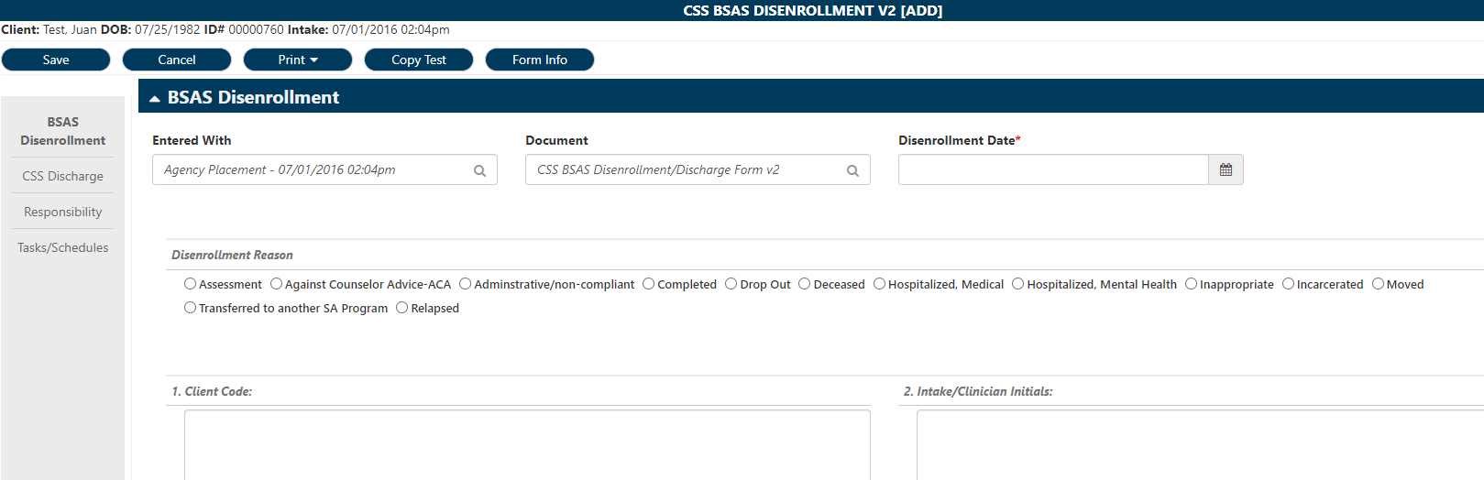
BSAS Disenrollment/Discharge Form

Slide 25
Activity
In Development, open a client chart and practice completing the Residential Discharge Summary

Slide 26

Gracias!

